Slide 1
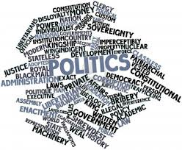
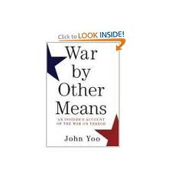
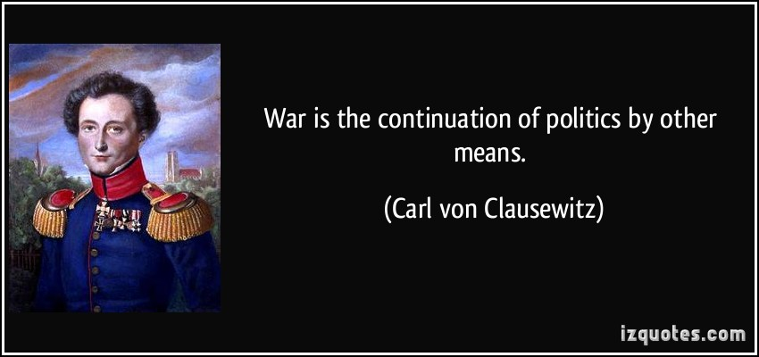
Politics and Political Thinking
“War by other means”

Slide 2
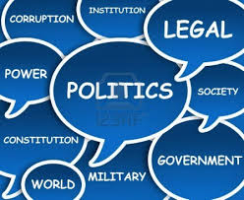
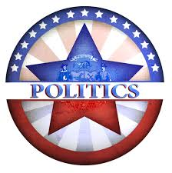
What is Politics?
Def. The means which society settles its conflicts and allocates the resulting benefits and costs.
Huh?
How we settle arguments and divide the positives (benefits) and negatives (costs) among people.

Slide 3
Power
Those who prevail in politics have POWER. (ability of one person to get another person to act in accordance with the first person’s intentions)
How do we determine who has power in the U.S.?

Slide 4
Determinants of Power
Democracy
Constitutionalism
Free Market
These three concepts or “rules” are designed to keep politics peaceful and create a peaceful transfer of power between groups.

Slide 5
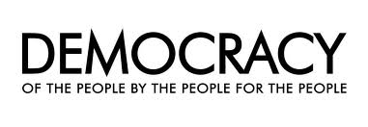
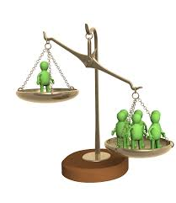
Democracy
Government by the people either directly or through representatives.
Through democracy, the majority rules (by direct vote or representatives controlling branches of government)
However, it isn’t that simple…

Slide 6
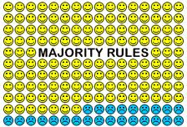
Majoritarianism
Def. the idea that the majority prevails not only in elections but also in policy determination.
Ex. Obama had more popular and electoral votes than Romney in the 2012 presidential election
Ex. Congress, controlled by Democrats, passed comprehensive healthcare reform law (Obamacare) in 2010.
Ex. Because of public opinion against involvement in Syria, Pres. Obama did not bring military action to a vote in Congress that he would likely lose.

Slide 7
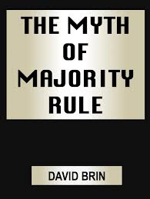
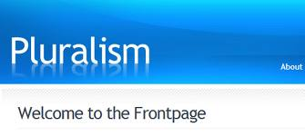
Pluralism
Def. Theory that American politics are determined by the power exercised by interest groups, rather than the majority.
Why? Most Americans are only concerned with major issues that impact them directly. Therefore, the majority does not weigh in on issues that do not impact the nation as a whole.
Ex. Immigration is a larger issue in Arizona than Iowa.
Ex. Govt. support for hurricane victims important on the Gulf Coast, not on the Atlantic Coast (until hurricane Sandy…)

Slide 8
Authority
In government, officials have the Authority (right to use power) due to the positions they hold, even without support of the majority. Government officials have to make unpopular decisions for the good of the nation (in their opinion...)
Ex. Pres. Obama using air strikes in Libya in 2011
Ex. New York Court of Appeals striking down capital punishment laws in NYS because of how it was written, despite a majority of New Yorkers who supported the death penalty.

Slide 9
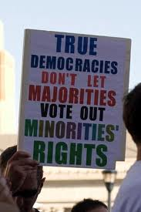
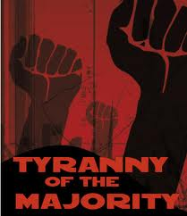
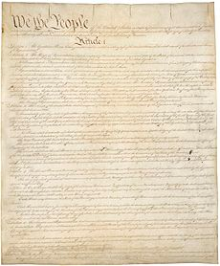
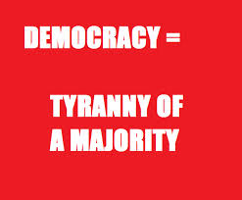
A Constitutional System
Def. The idea that there are lawful limits on the power of government.
Constitutions and laws limit the power of democracy to prevent a “tyranny of the majority” where the rights of the minority are trampled by majority rule.

Slide 10
Examples of Constitutionalism
Division of power between branches of govt.
Checks and Balances
Federalism
The Bill of Rights
Judicial Action: The use of courts of law as a means by which individuals protect their rights and settle conflicts
Ex. Brown v. Board of Education of Topeka
Ex. Roe v. Wade

Slide 11
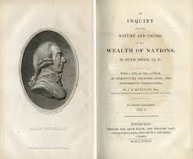
Free-Market System
Def. An economic system based on the idea that government should interfere with economic transactions as little as possible.
Based on the ideas of:
Private Property
Free Enterprise
Self-Reliance

Slide 12
Evolution of the U.S. Free Market
Laissez-Faire: Government stays out of the economy. Belief in traditional Capitalist economics where government involvement only causes problems.
Progressivism: Belief the government must act to check the power of big business (monopolies).
New Deal: Belief the government actions can directly impact the economy (Keynesian Economics) and government must provide a safety net for the poor.
“Reganomics”: Govt. should be less involved in economy while providing incentives for investment in the nation, improving it for everyone (Supply Side Economics).

Slide 13
Free Market cont.
Despite these changes in philosophy, the U.S. is still a Free Market economy, with less government intervention (and taxes) than most of the rest of the world.

Slide 14
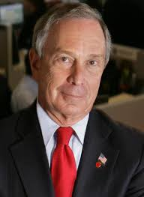
Corporate Power and Elitism
Corporate Power: Power of corporations to influence government and maintain control of the workplace
Elitism: Wealthy and well-connected individuals exercise power over certain areas of public policy
While many feel these have a negative impact on society, they serve an important function, representing their respective areas of society, and often broader interests than their own.
Ex. Bill and Melinda Gates Foundation
Ex. Ex-NYC Mayor Bloomberg

