Slide 1
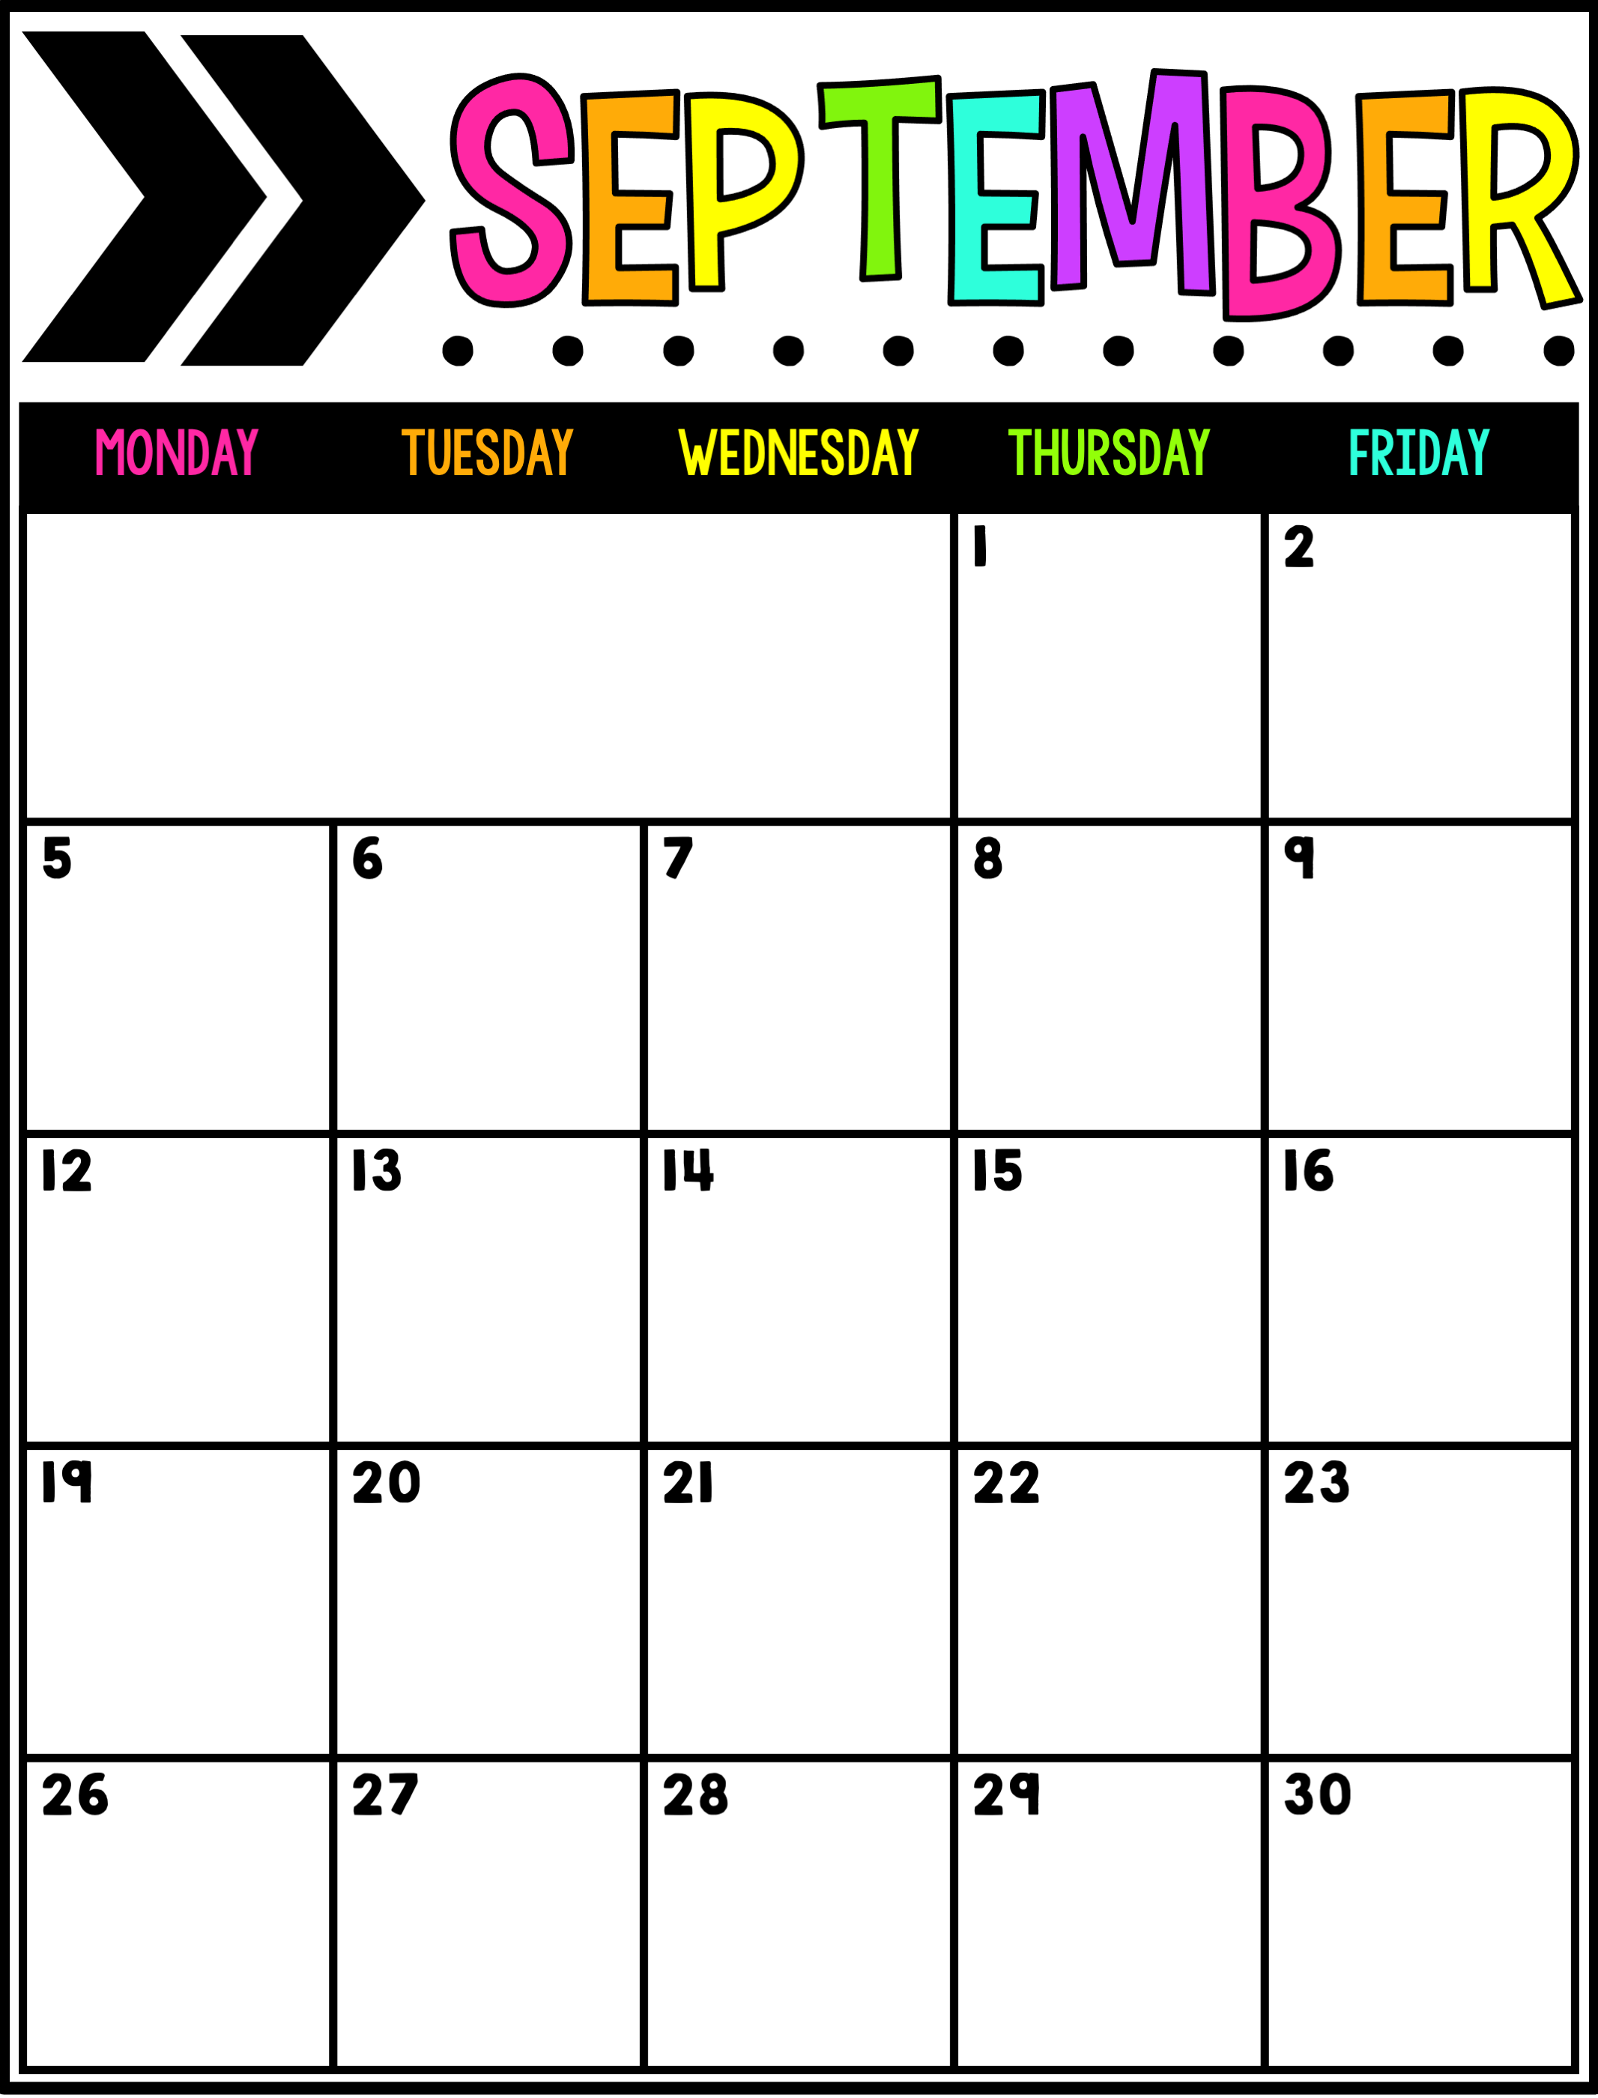
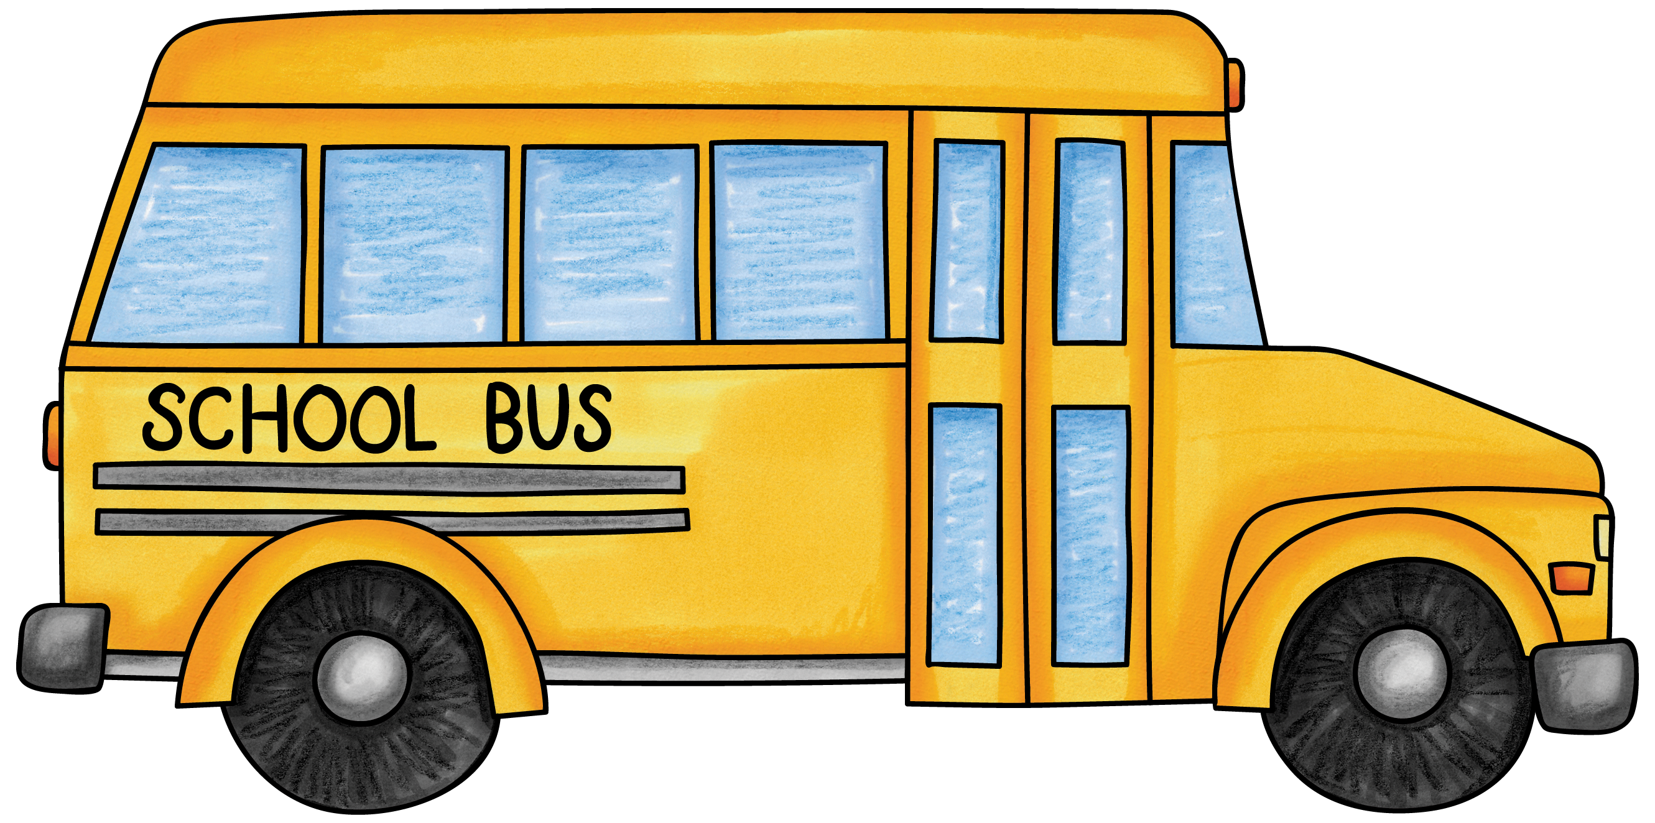
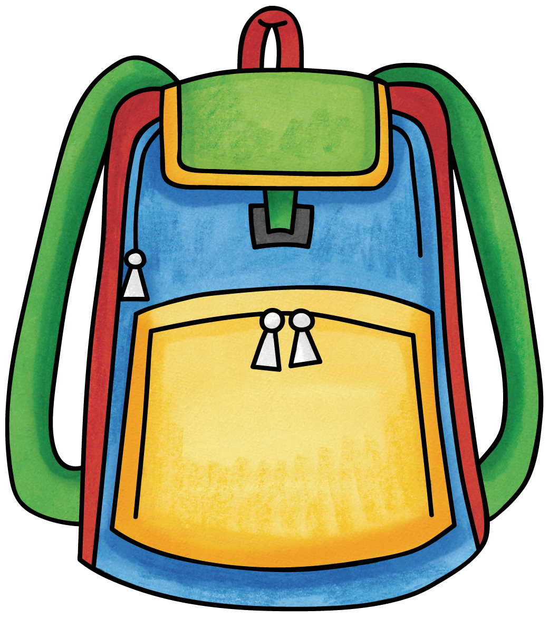
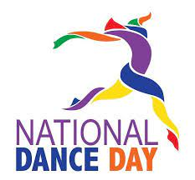
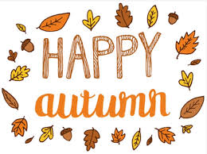
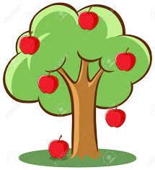
A Day
1st Day of
B Day
C Day
Teddy Bear Day
D Day
A Day
Roald Dahl Day
B Day
C Day
D Day
Mexican Independence Day
A Day
National Dance Day
B Day
C Day
International Peace Day
D Day
Fall Begins
A Day
B Day
Johnny Appleseed Day
C Day
D Day
A Day
B Day

Slide 2
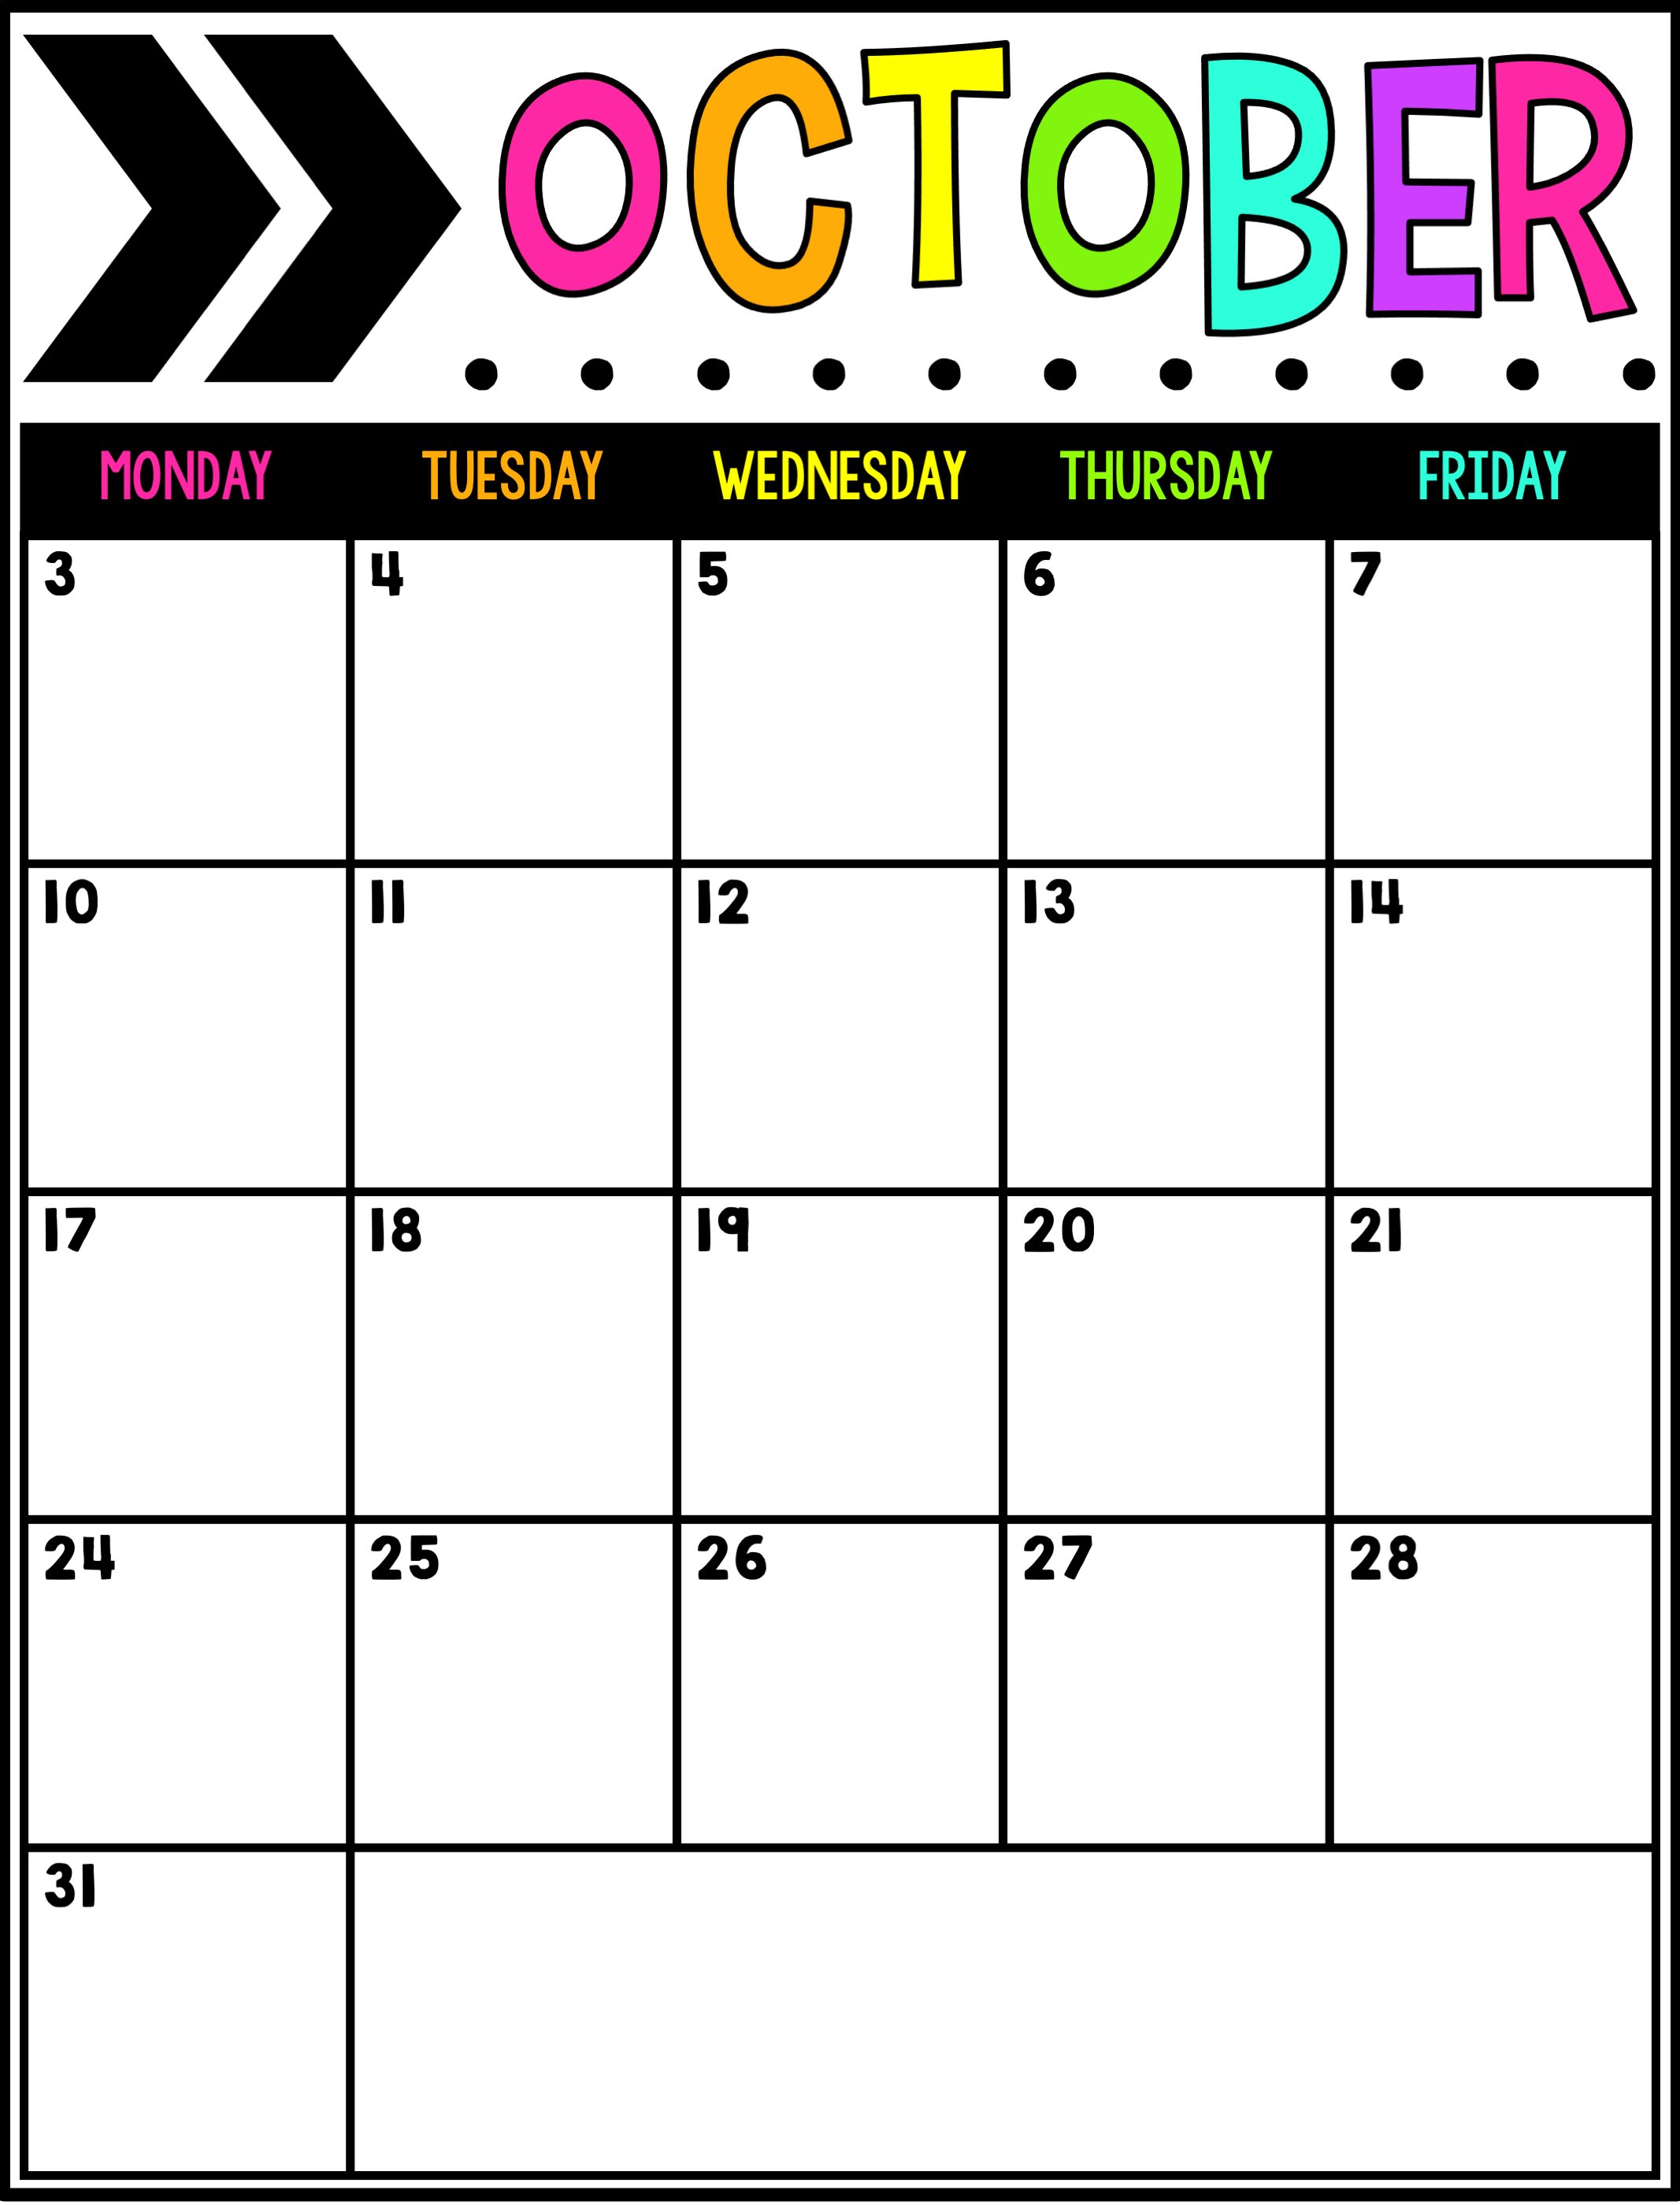
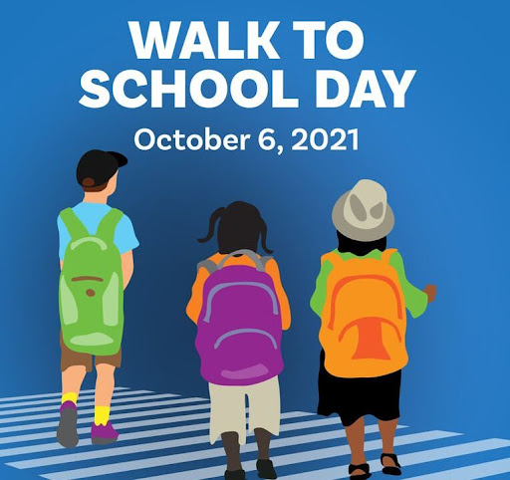
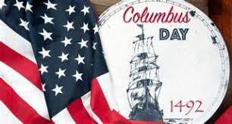
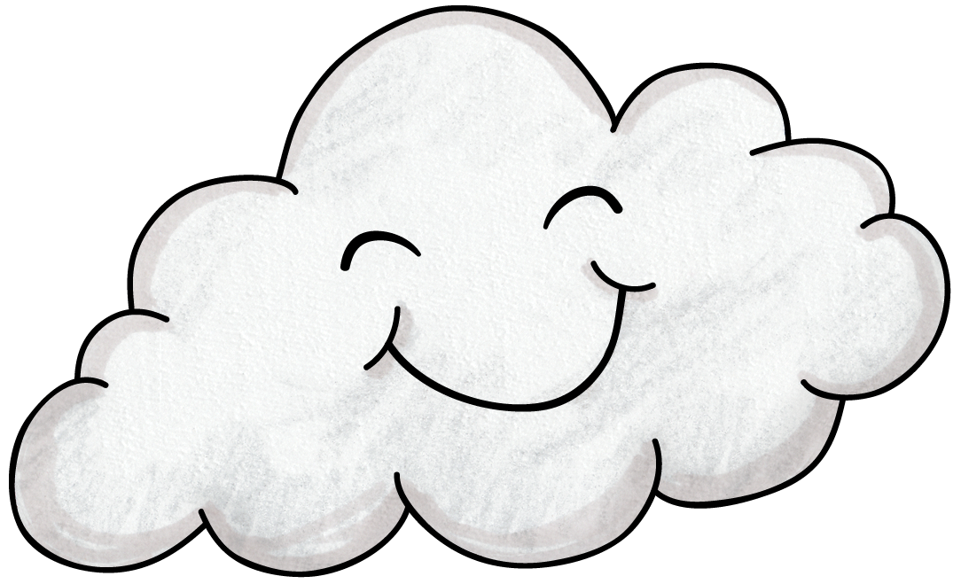
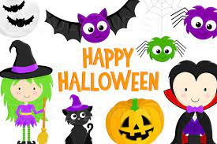
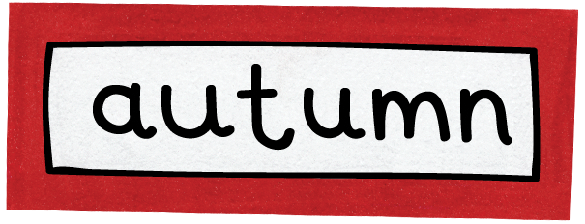
C Day
D Day
National Taco Day
A Day
B Day
National Walk to School Day
C Day
D Day
A Day
B Day
National Stop Bullying Day
C Day
National Dessert Day
No School
D Day
A Day
Prophet Mohammad
Birthday (Muslim)
B Day
C Day
D Day
National LGBTQ
Spirit Day
A Day
Hindu Diwali Day
B Day
C Day
D Day
A Day
National First Responders Day
B Day

Slide 3
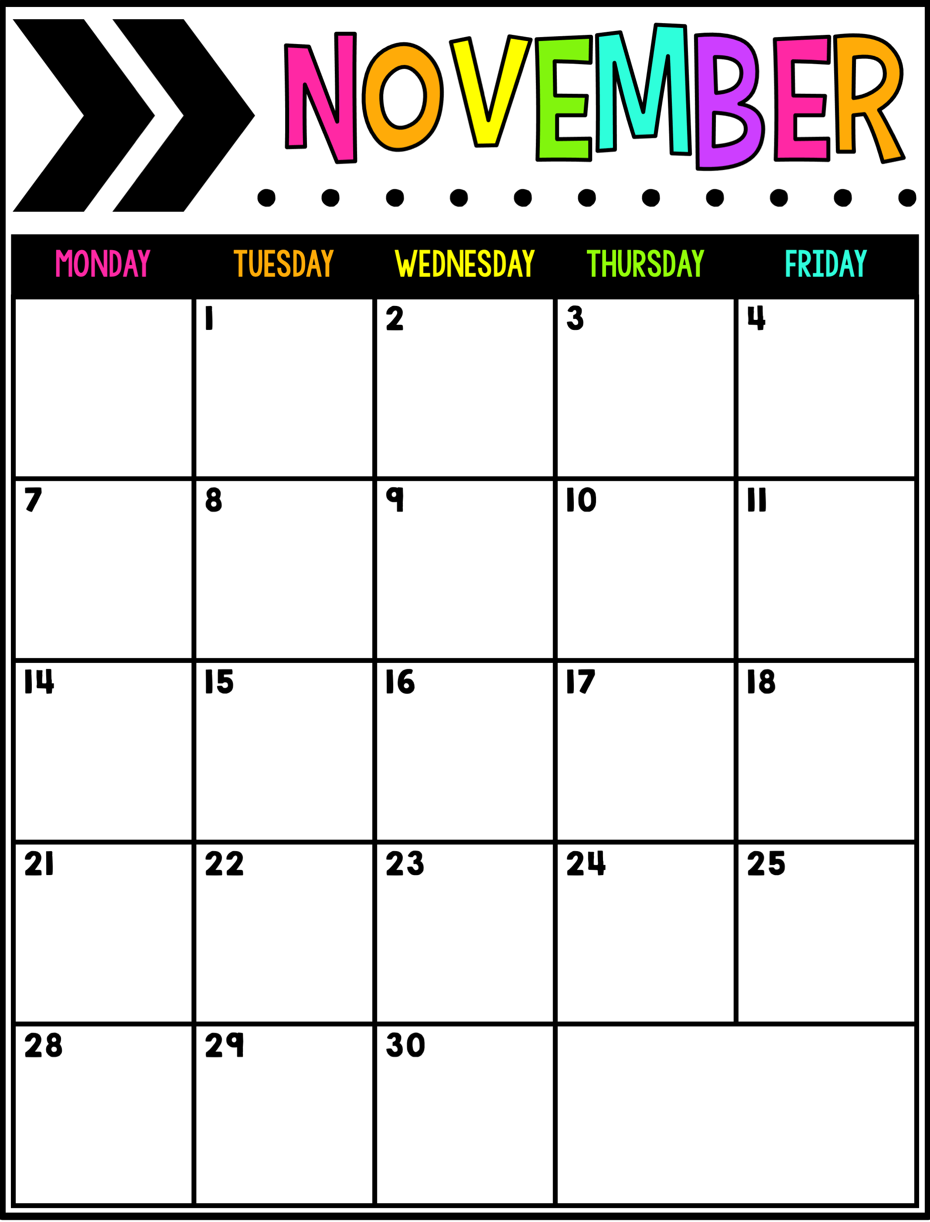
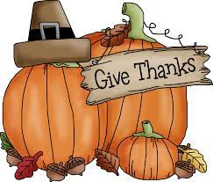
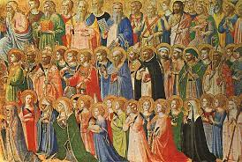
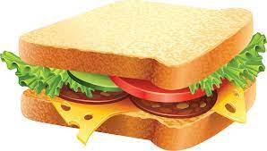
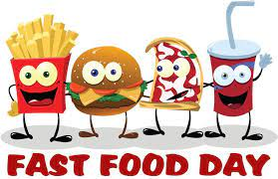
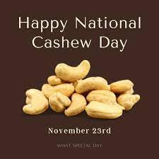
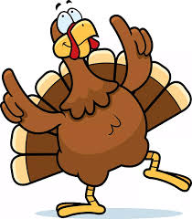
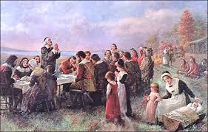
C Day
All Saint’s Day
D Day
A Day
Sandwich Day
B Day
½ Day
C Day
No School
D Day
World Freedom Day
A Day
No School
Veteran’s Day
B Day
C Day
D Day
A Day
B Day
C Day
D Day
No School
No School
Thanksgiving Day
No School
Black Friday
A Day
B Day
C Day

Slide 4
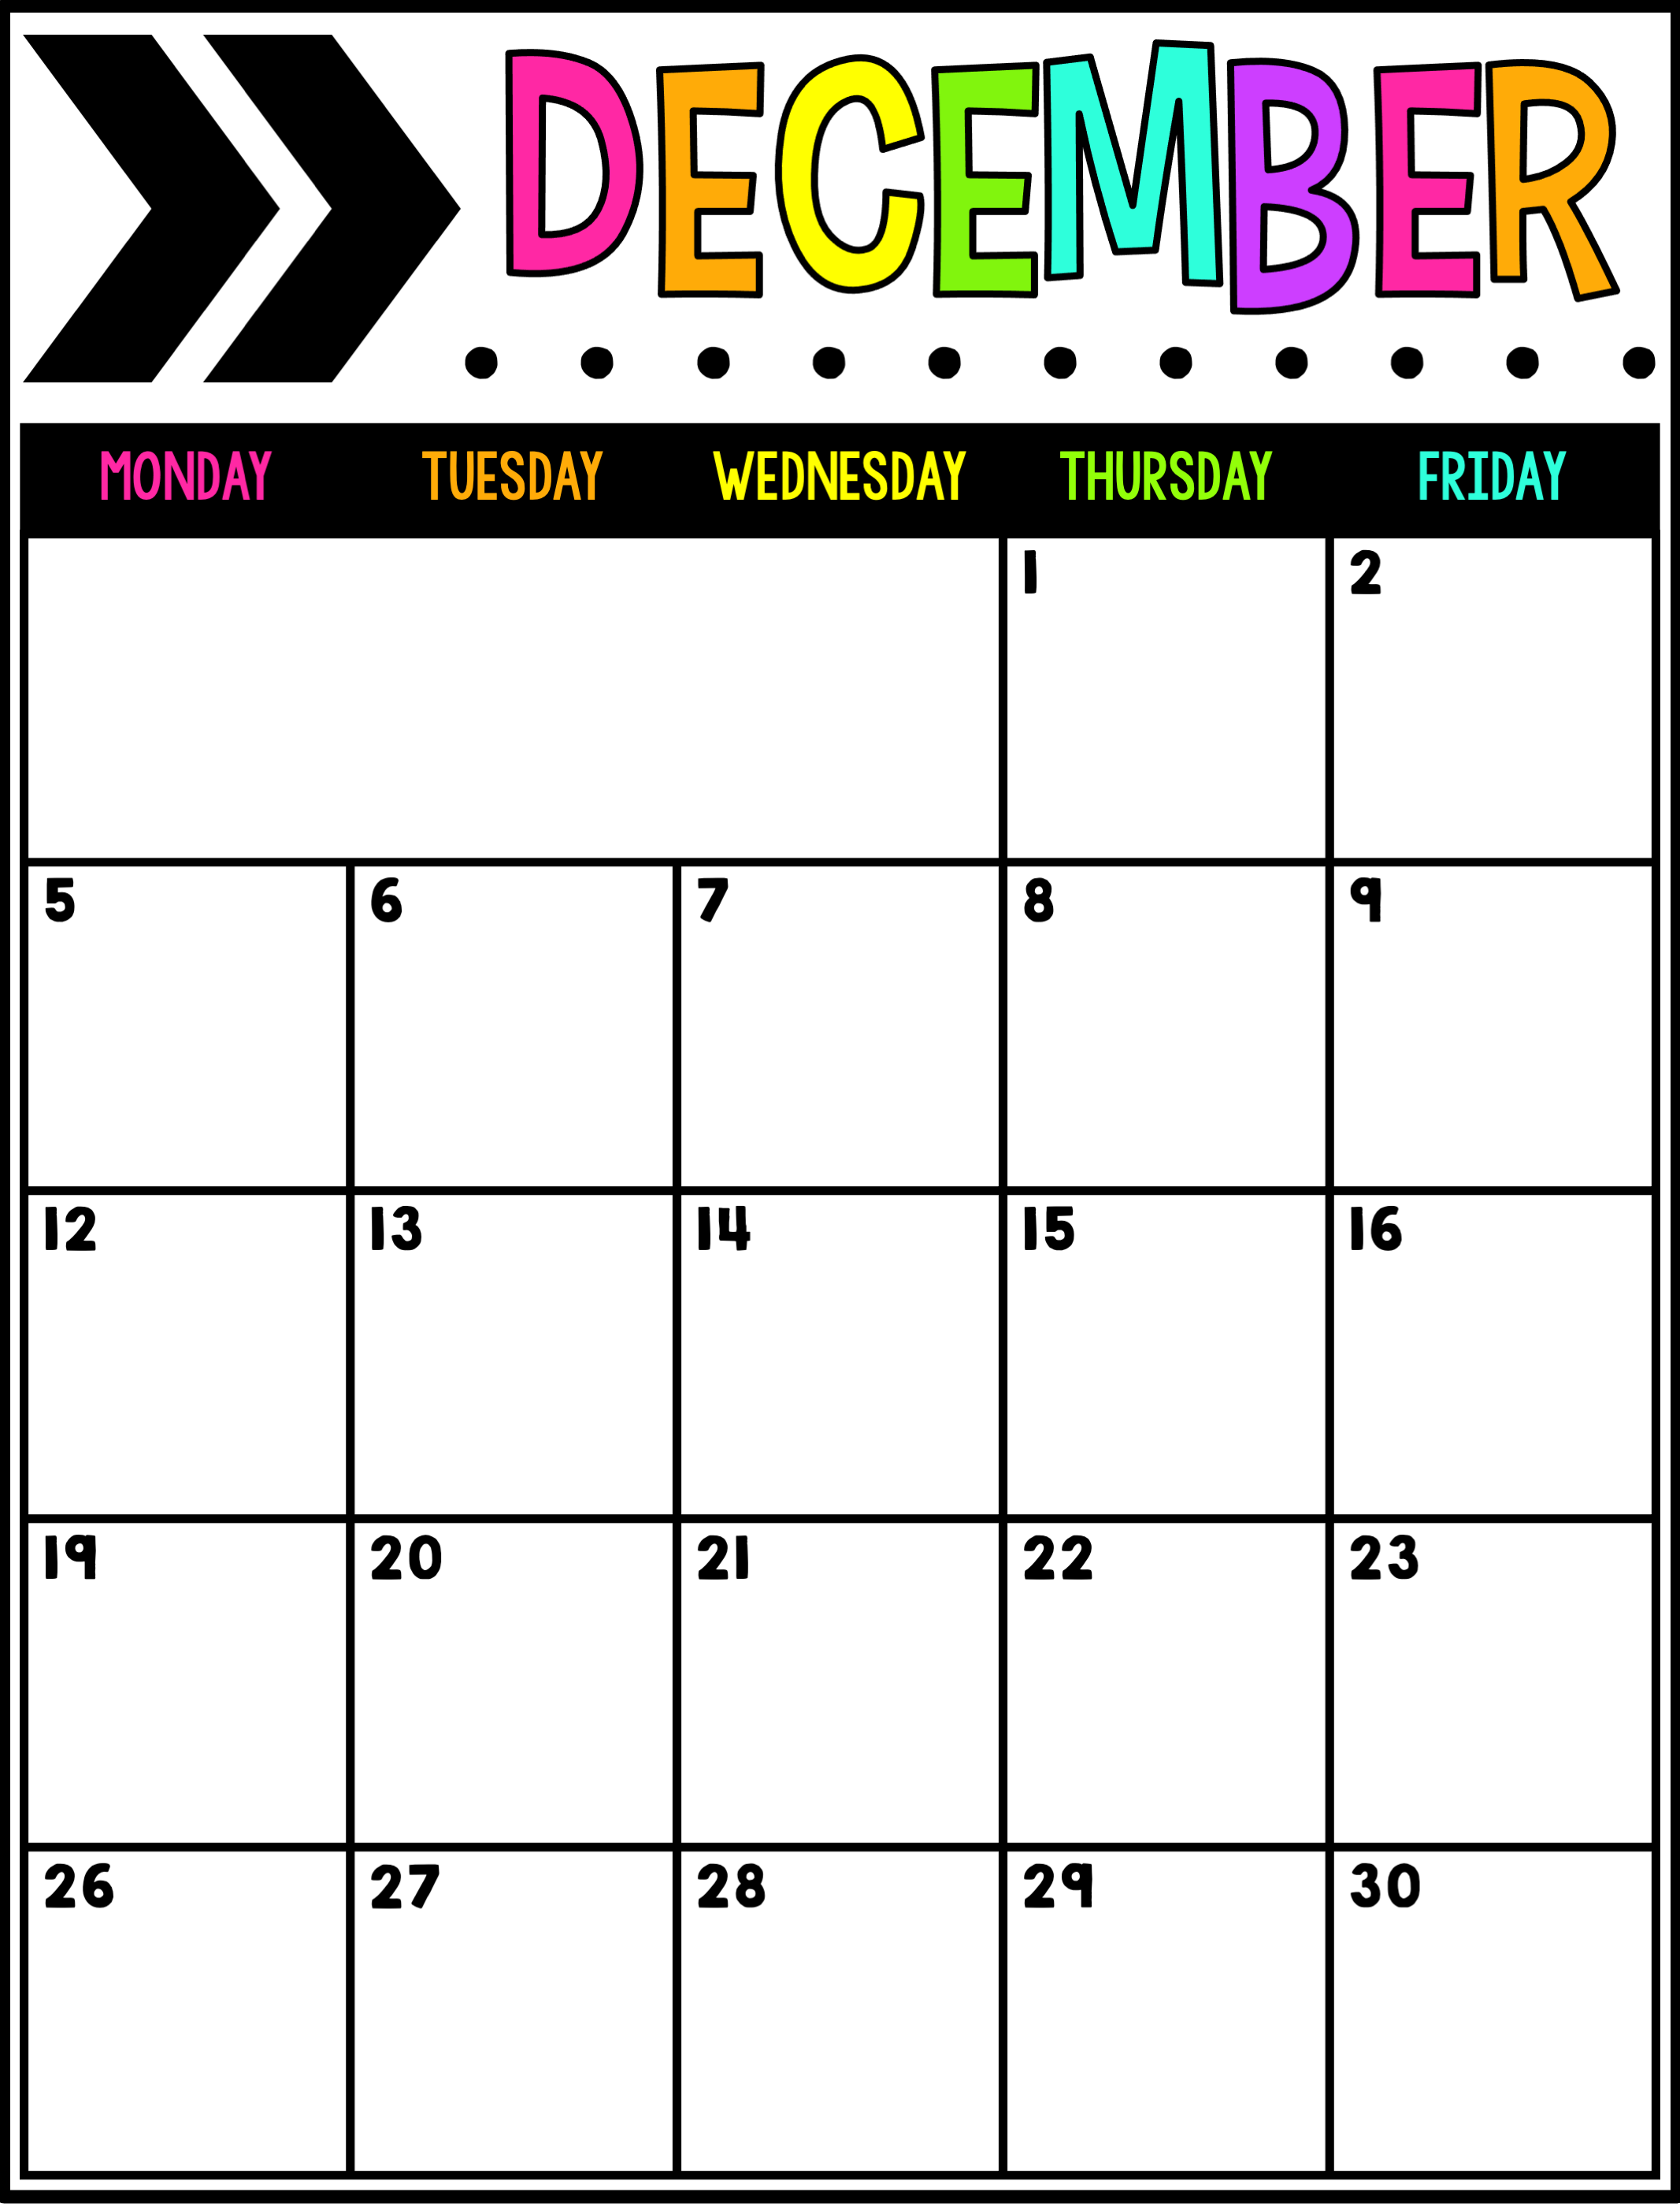
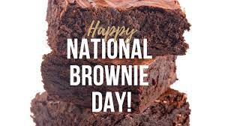
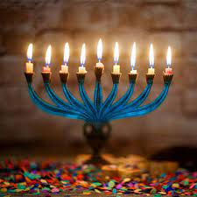
D Day
A Day
B Day
C Day
D Day
A Day
B Day
½ Day
C Day
D Day
A Day
B Day
C Day
D Day
Hanukkah Begins (18th)
A Day
B Day
First Day of Winter
C Day
D Day
No School
Winter Holidays

Slide 5
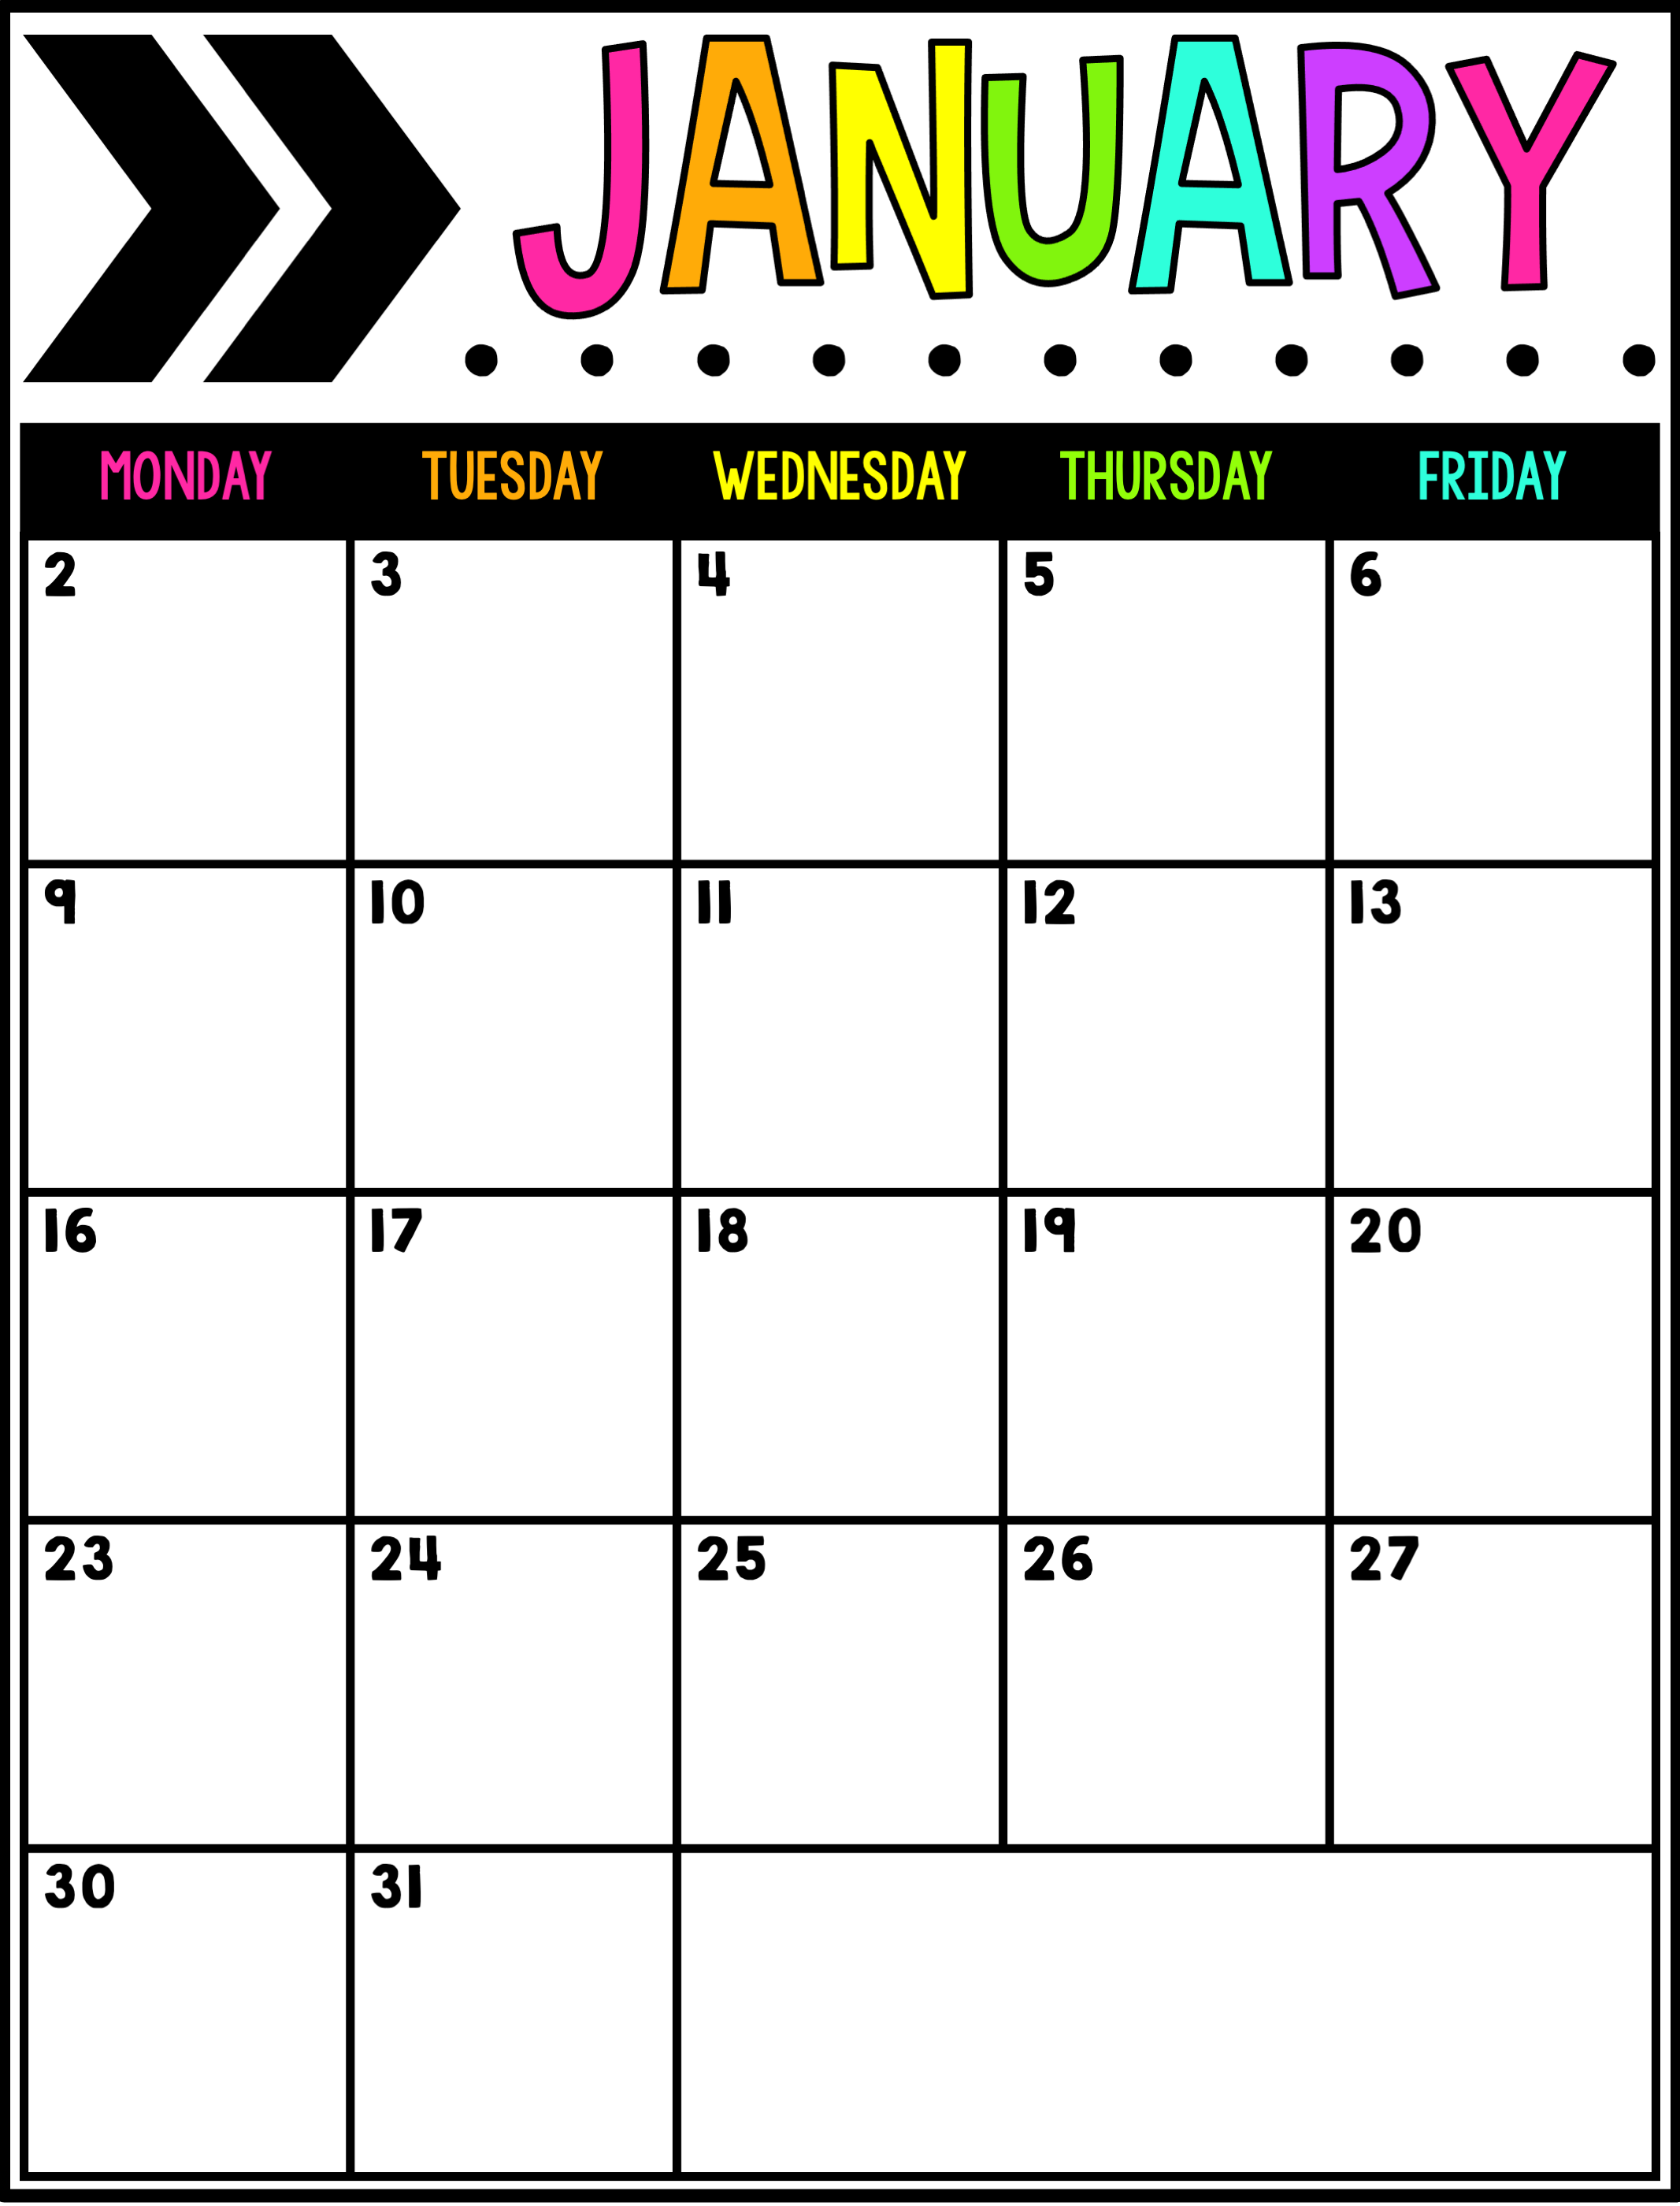
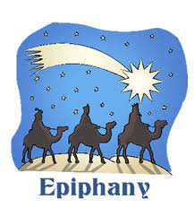
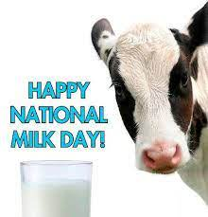
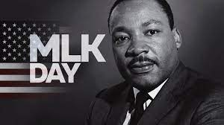
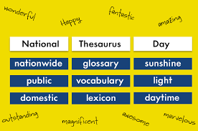
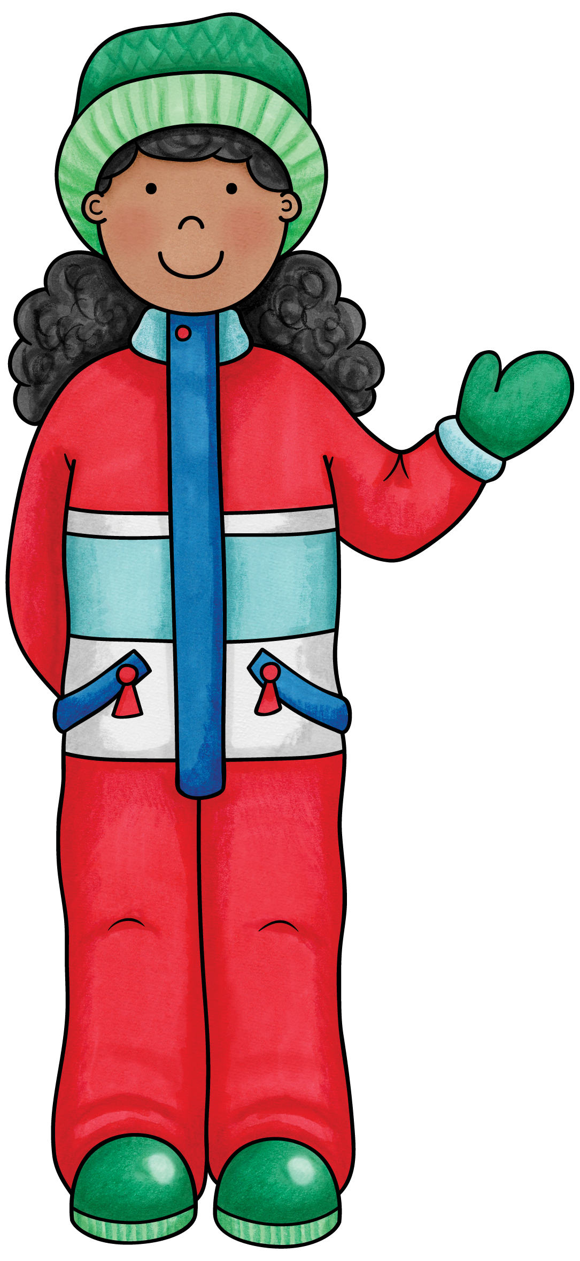
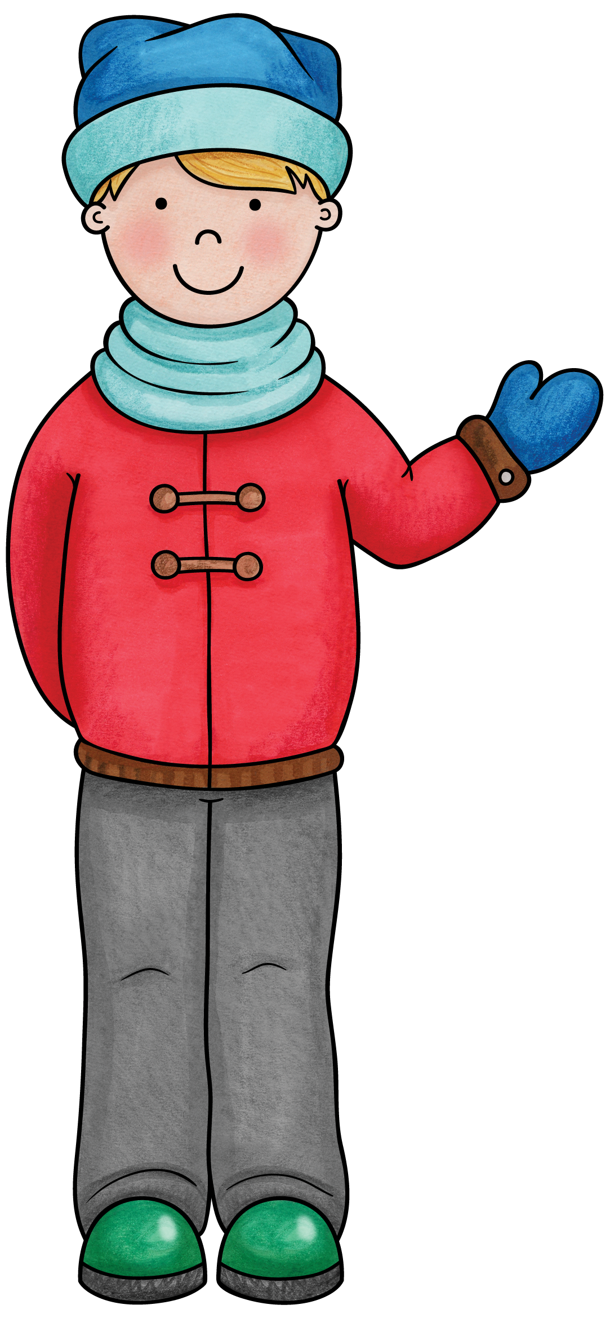
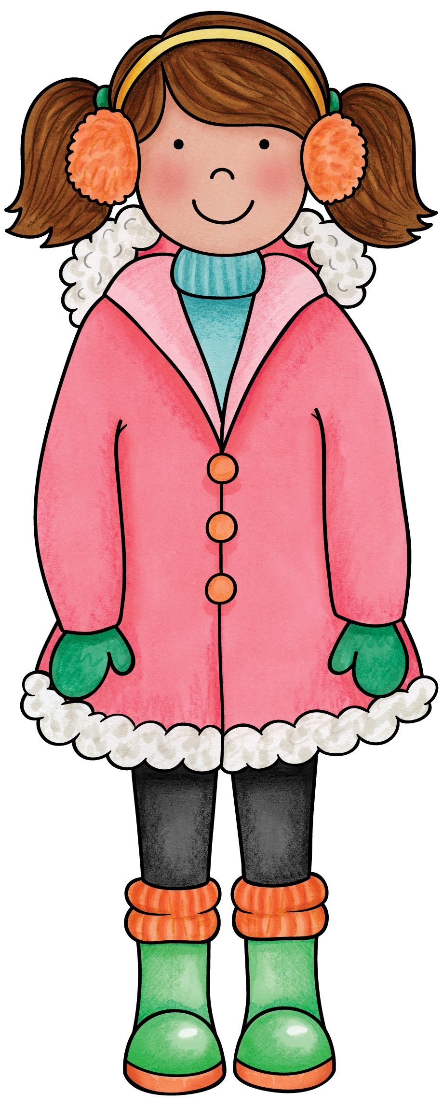
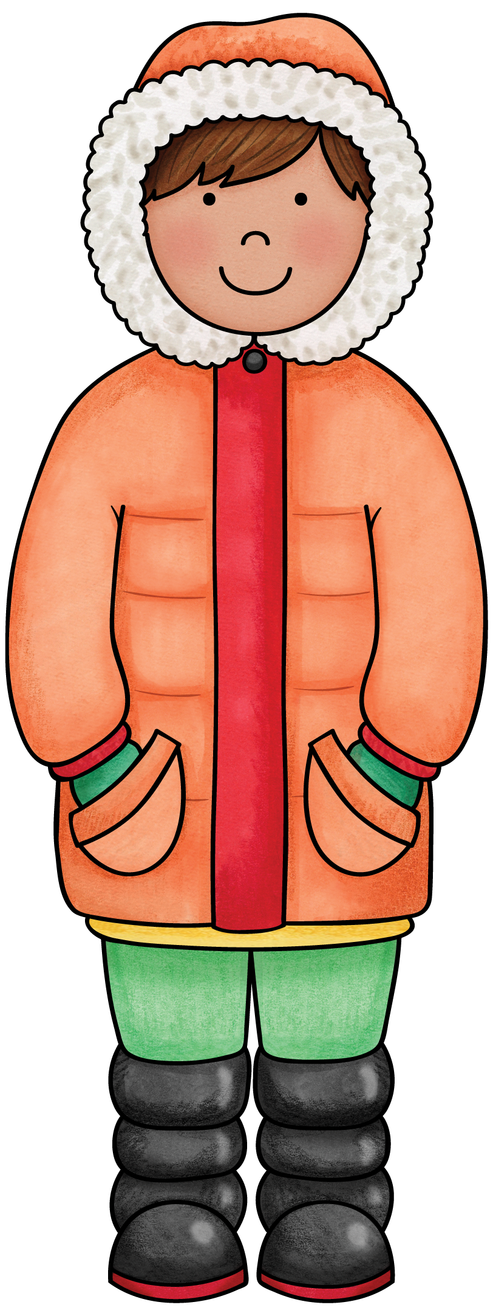
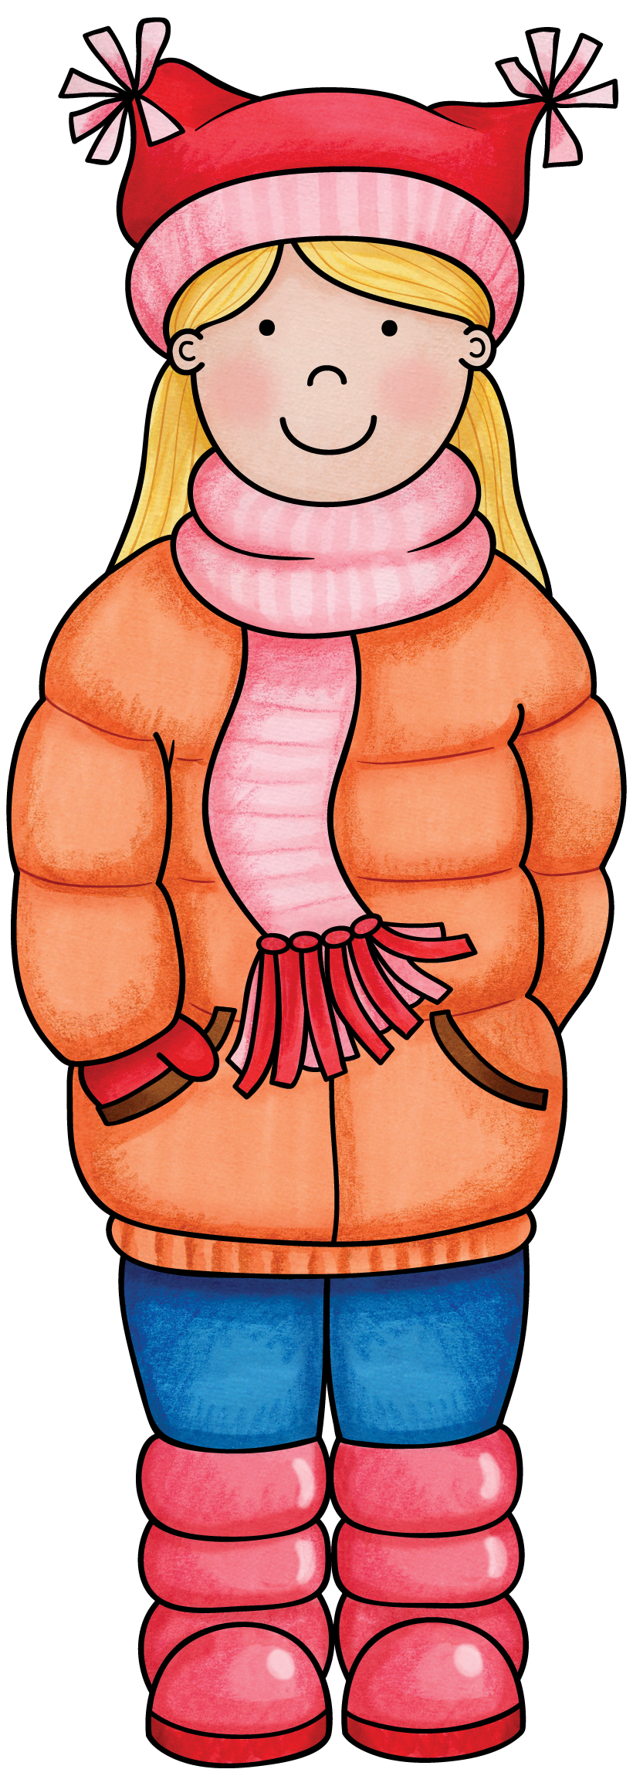
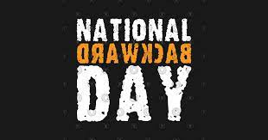
No School
A Day
B Day
C Day
D Day
A Day
B Day
C Day
D Day
A Day
No School
B Day
C Day
D Day
A Day
B Day
C Day
D Day
A Day
B Day
C Day
D Day

Slide 6
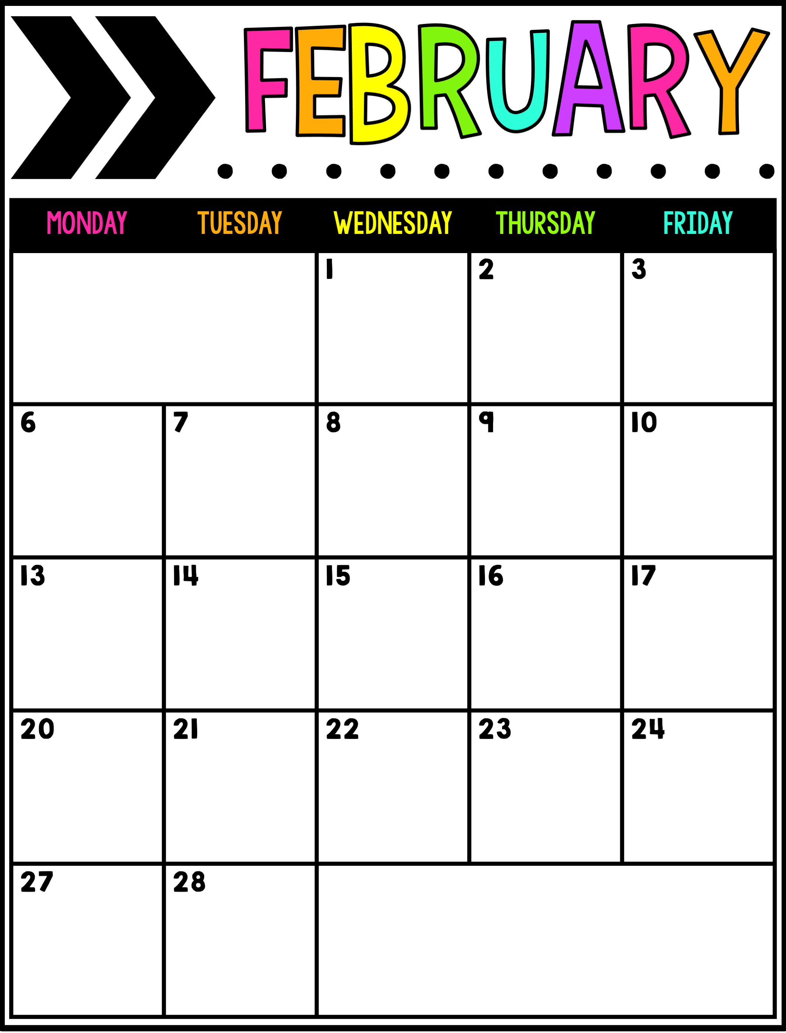
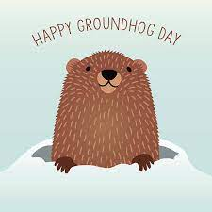
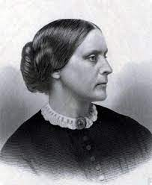
A Day
B Day
C Day
D Day
A Day
B Day
C Day
D Day
A Day
B Day
C Day
D Day
A Day
Valentine’s Day
No School
President’s Day
February Break
B Day
C Day

Slide 7
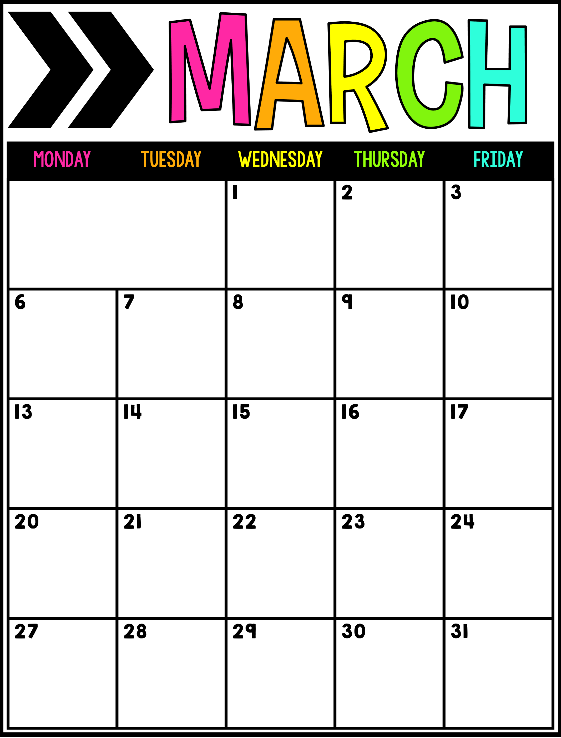
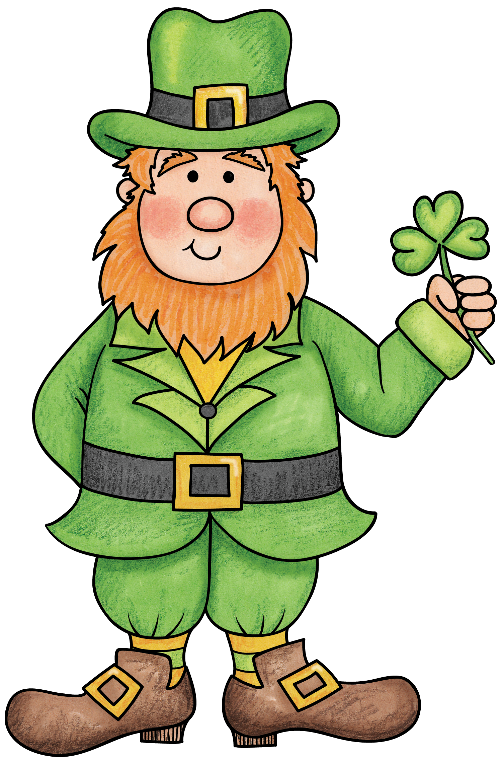
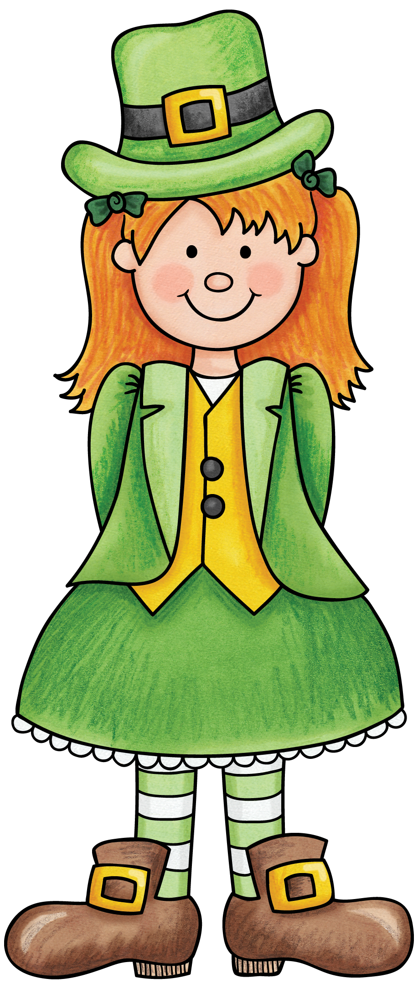
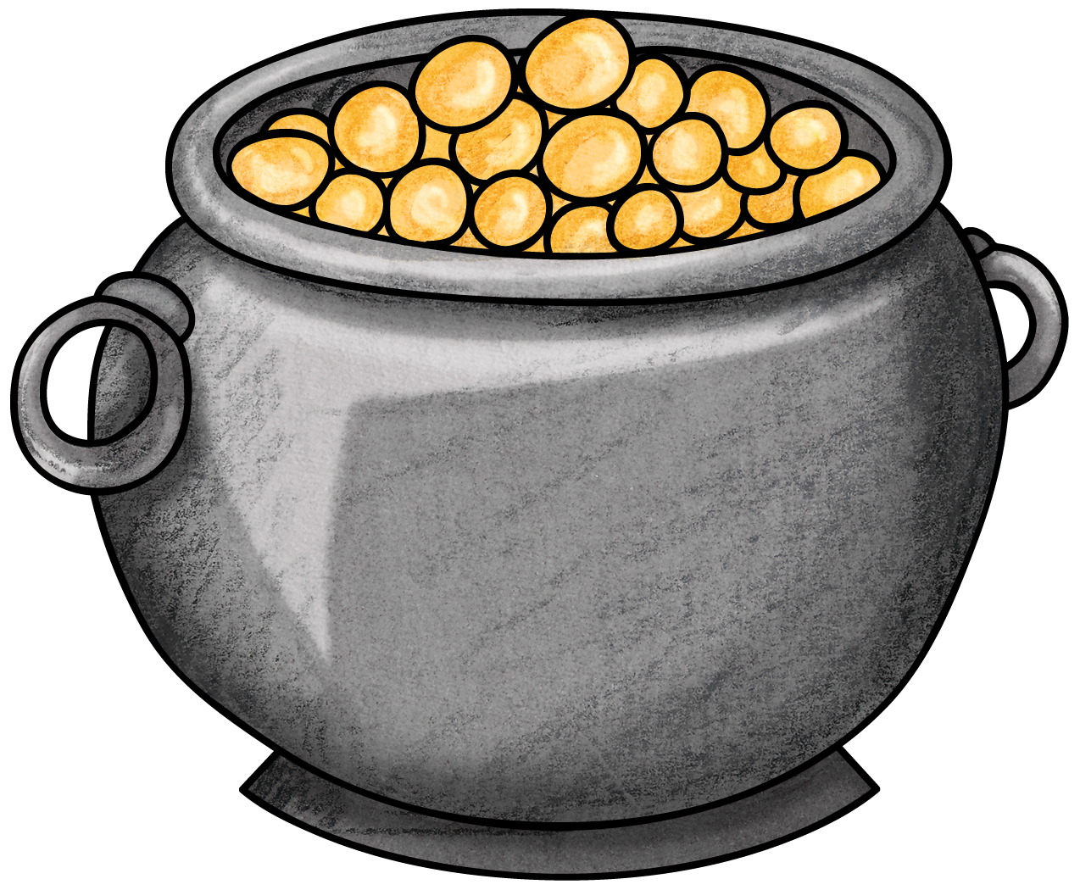
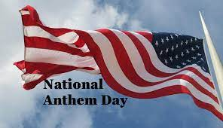
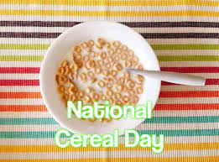
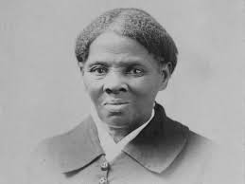
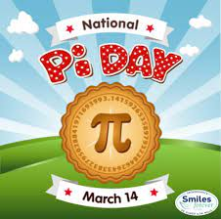
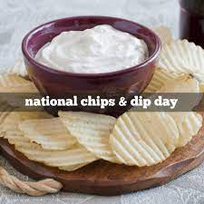
D Day
A Day
B Day
½ Day
C Day
D Day
A Day
B Day
C Day
D Day
A Day
B Day
C Day
D Day
A Day
B Day
C Day
D Day
A Day
B Day
C Day
D Day
A Day
B Day

Slide 8
No School
Spring Break
C Day
D Day
A Day
B Day
C Day
D Day
A Day
B Day
C Day
D Day
NYS
ELA Assessment
A Day
B Day
C Day
D Day
A Day

Slide 9
B Day
C Day
D Day
A Day
No School Superintendent’s Conference Day
NYS
Math Assessment
B Day
C Day
D Day
A Day
B Day
C Day
No School Superintendent’s Conference Day
D Day
A Day
B Day
½ Day
C Day
D Day
A Day
B Day
C Day
D Day
A Day
No School
Memorial Day

Slide 10
B Day
C Day
Indian Citizenship Act of 1924
D Day
A Day
B Day
C Day
D Day
A Day
B Day
C Day
D Day
A Day
B Day
C Day
D Day
No School
Juneteenth Observance
Summer
Break

