Slide 1
Identity
Mask Making

Slide 4
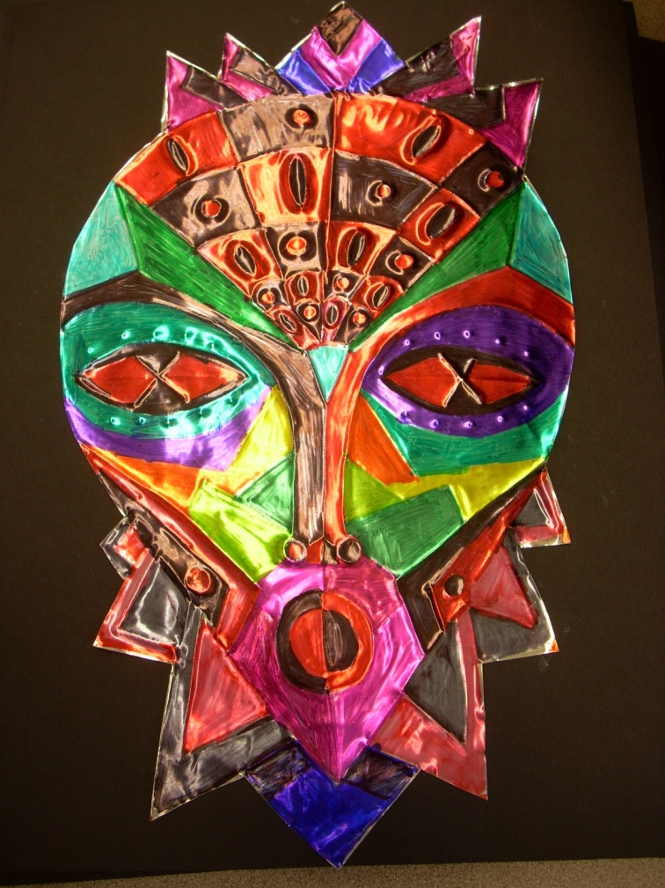
What is a mask used for?
To disguise
To conceal
To hide
To cover
Enhancement
Protection
Entertainment

Slide 5
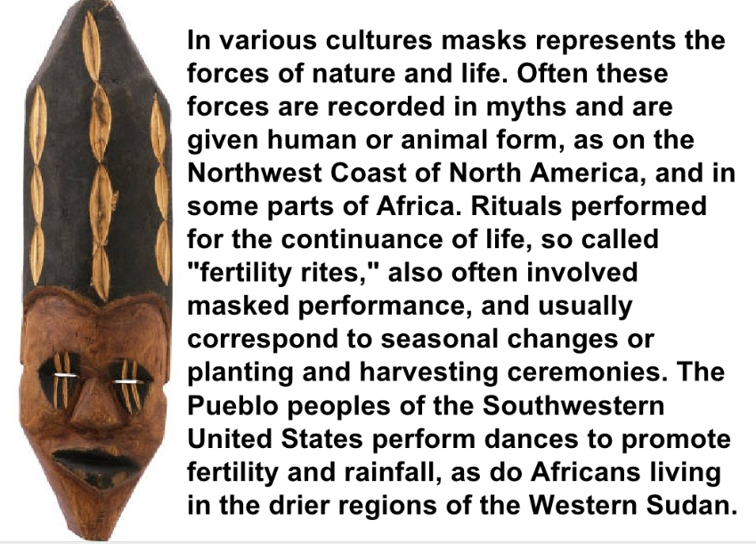

Slide 6
Ritual Masks
The function of the masks may be magical or religious;
To help mediate with spirits or
To offer a protective role to people who wear and use the masks powers

Slide 7
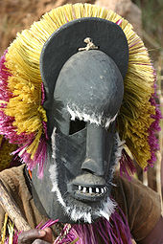
In West Africa masks are used to communicate with spirits

Slide 11
North American Masks

Slide 13
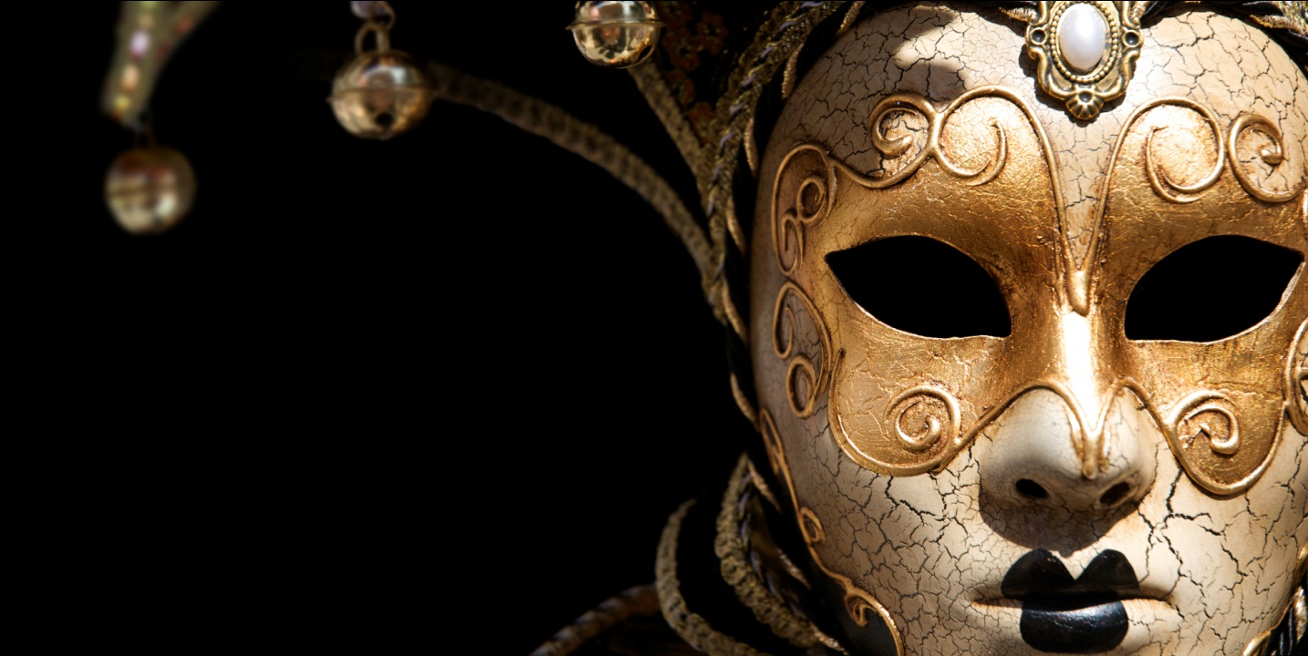
Venetian Masks
Masks have always been a part of the Venetian carnival
Venetian people used masks to hide whether they were poor or rich

Slide 14
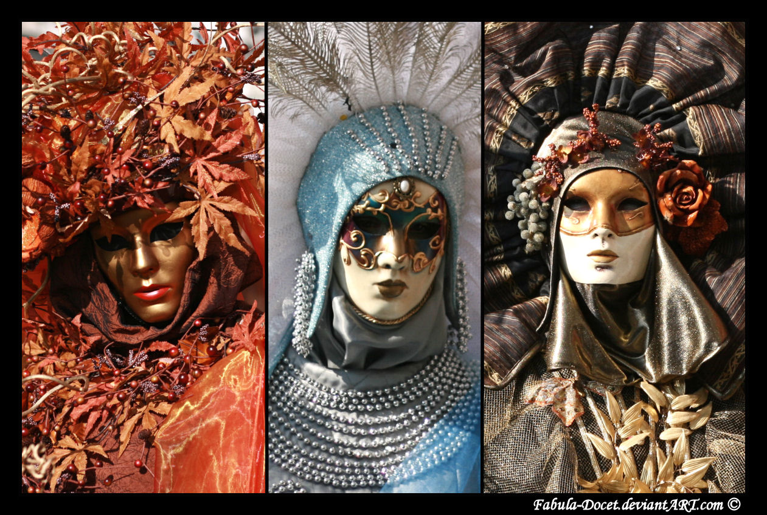

Slide 15
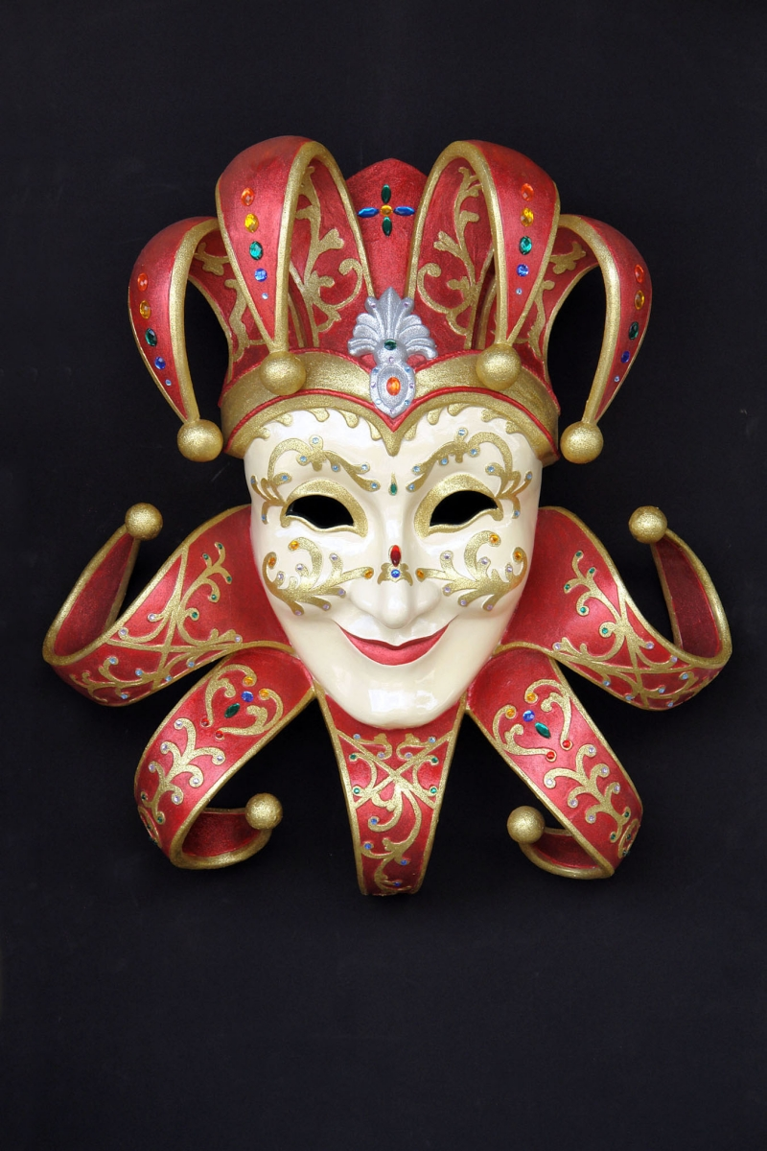
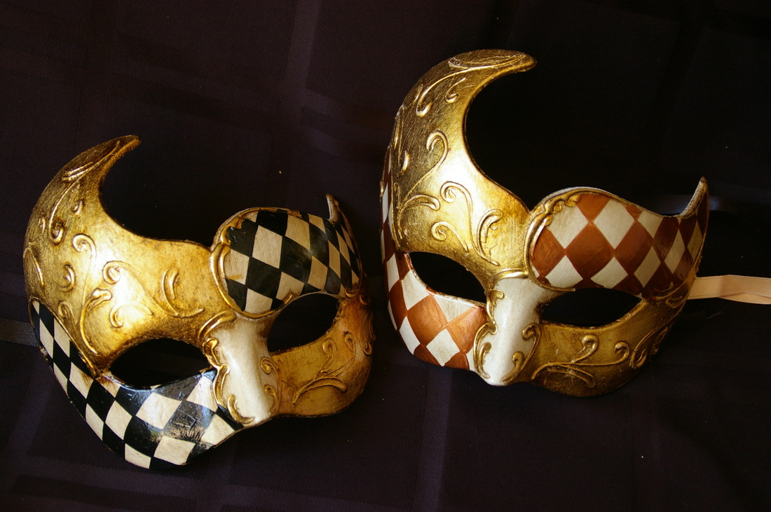

Slide 16
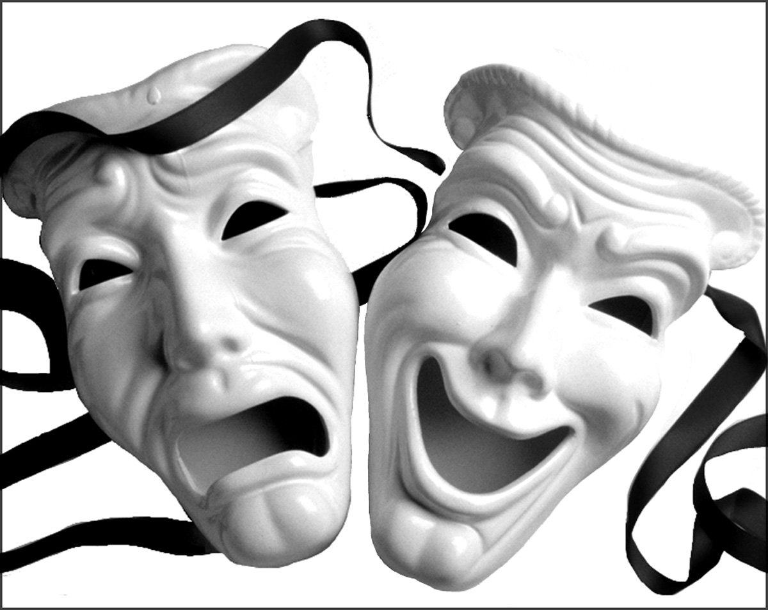
Mask in Theatre
Masks play a key part in world theatre traditions

Slide 17
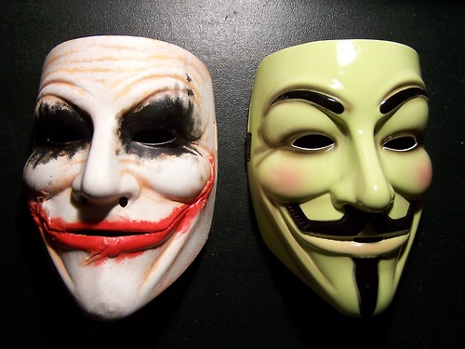

Slide 18
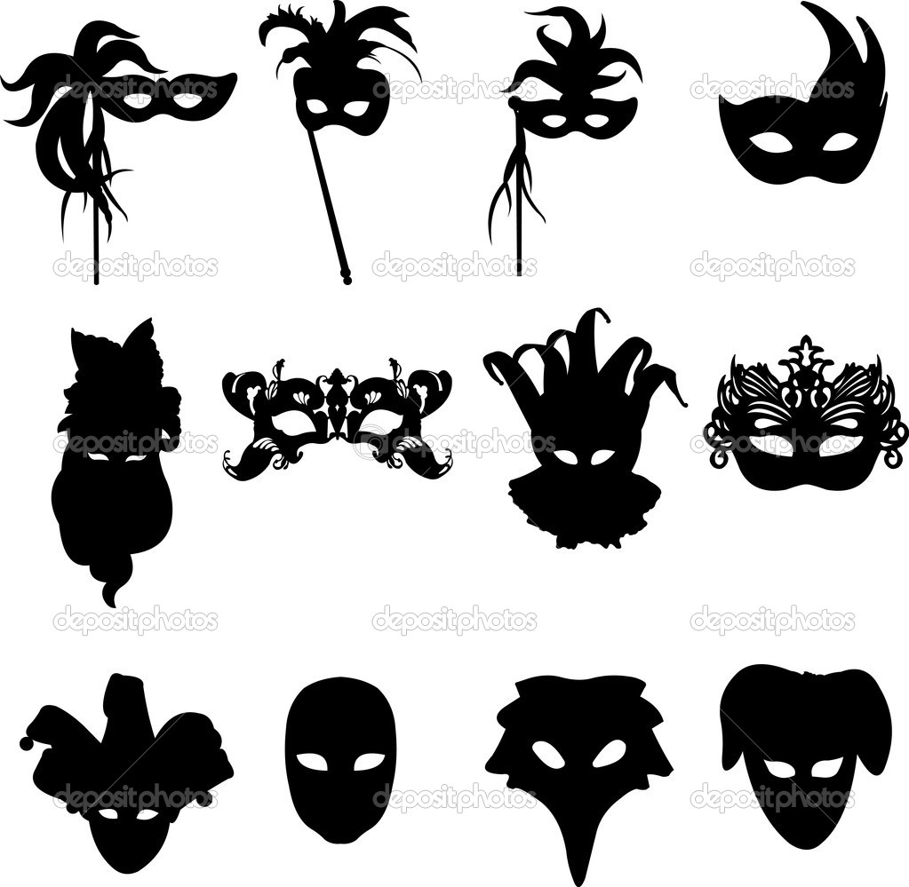
Mask Styles

Slide 19
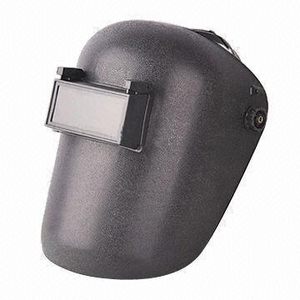
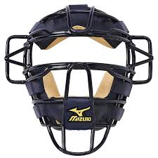
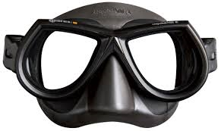
Protective Masks:

Slide 20
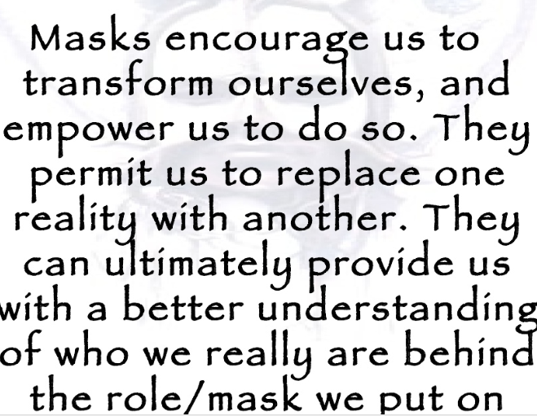
every morning and take off at night.

Slide 22
Making your own mask
Choose an Identity
Choose a style
Create brainstorm sketches

Slide 23
Sketching your design

Slide 24
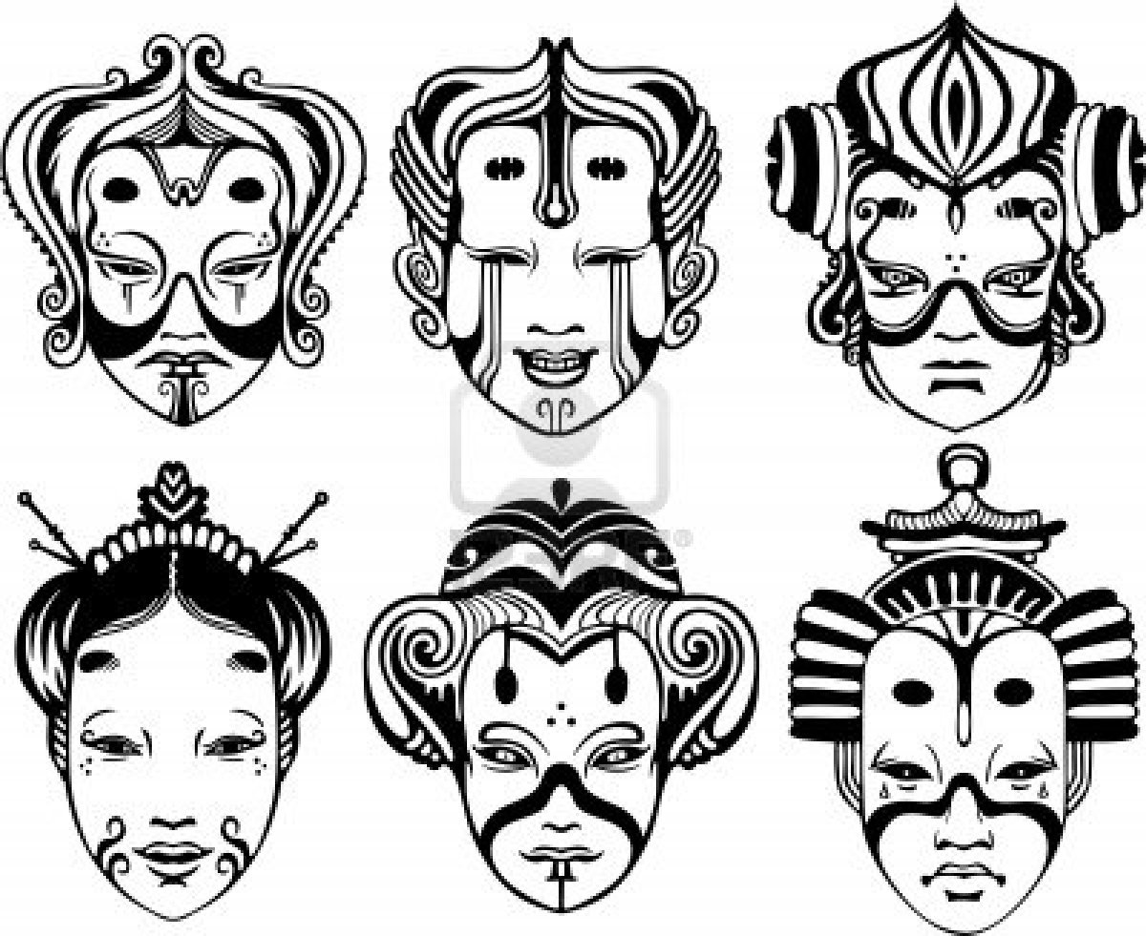

Slide 25
Your Assignment:
Create a functional mask using the “slab method” with 3D sculptural additions.
8 inches tall x 6 inches wide
One non-fired embellishment
Must have a meaning/purpose/reason (think self-portrait)

Slide 26
Steps:
Submit your notes and sketches
Roll a slab and use newspaper to give your mask the desired three dimensional effects
Slip and score your sculptural additions
Make a hook or holes in the mask for functionality
Bisque fire
Paint with acrylic paint
Add non fired embellishment

