Slide 1
The Scientific Revolution
-or-
How to upset the Catholic Church

Slide 2
Can you think of any innovations or inventions that have changed society?

Slide 3
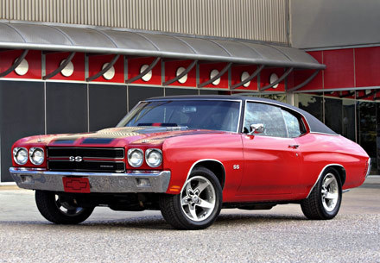
Is it any of this stuff?

Slide 4
Believe it or not, most of these things did not exist 100 years ago

Slide 5
Why So Few Inventions?
The Dark Ages
Very little education
Agrarian Society
No money

Slide 6
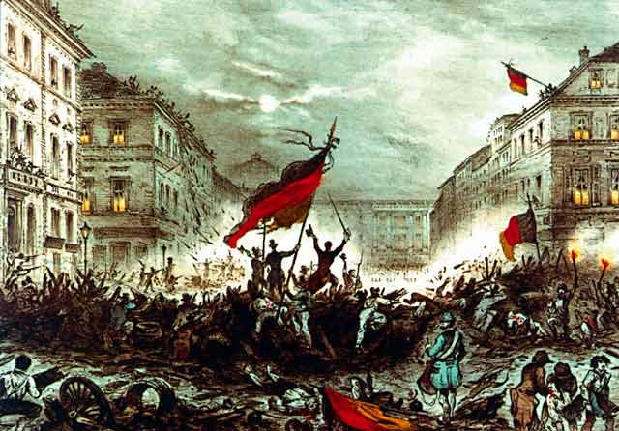
How do we define “Revolution?”
A major change that happens quickly

Slide 7
The Scientific Revolution
A major change in thinking when people began to use observation and thinking to answer questions about the world
Started during the 16th and 17th centuries (1500-1700)

Slide 8
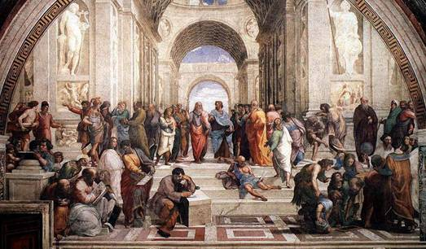
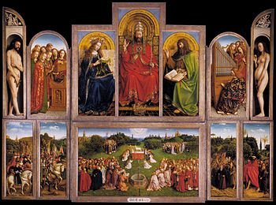
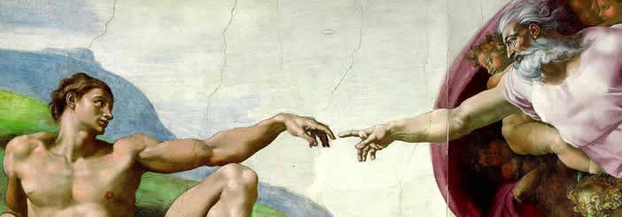
Causes of Scientific Revolution: RRAP
1: Renaissance: “Rebirth of learning and arts inspired curiosity

Slide 9
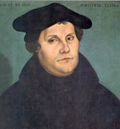
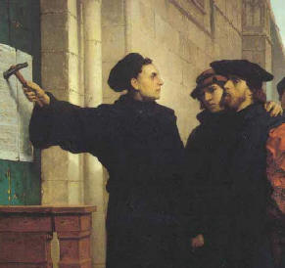
Causes of Scientific Revolution: RRAP
2: Reformation: New ideas about god and the power of the Catholic Church.

Slide 10
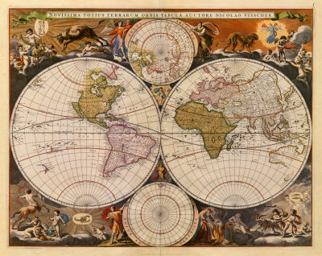
Causes of Scientific Revolution: RRAP
3: Age of Exploration: New knowledge of the world challenged old ideas, need better knowledge of astronomy and mathematics.

Slide 11
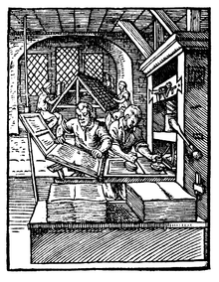
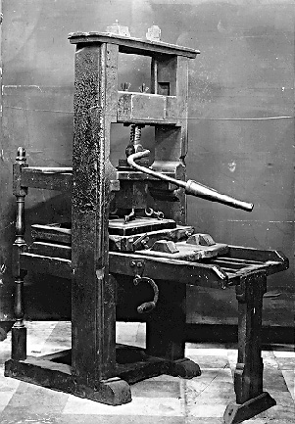
Causes of Scientific Revolution: RRAP
4: Printing Press - Helps spread new ideas and knowledge quickly.

Slide 12
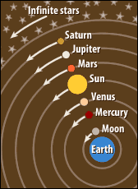
Terms and People
Geocentric Theory: The “old” belief that the earth was at the center of the universe

Slide 13
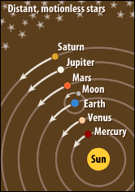
Terms and People
Heliocentric Theory: The “new” belief that the sun was at the center of the universe

Slide 14
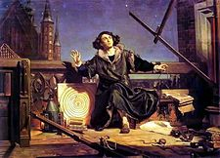
Terms and People
Nicolaus Copernicus: Astronomer first came up with Heliocentric Theory

Slide 15
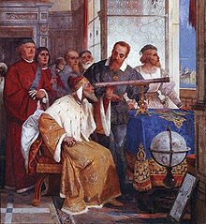
Terms and People
Galileo Galilei: Invented a telescope to help prove the Heliocentric Theory.

Slide 16
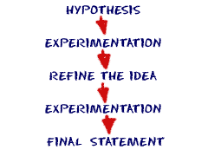
Terms and People
Scientific Method: Procedure for testing ideas based on observation and reason.

Slide 17
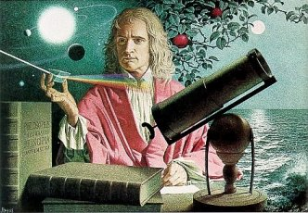
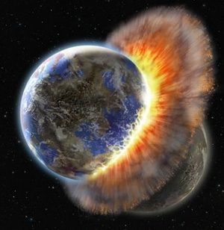
Terms and People
Isaac Newton: Scientist who discovered laws of gravity and planetary movement.

Slide 18
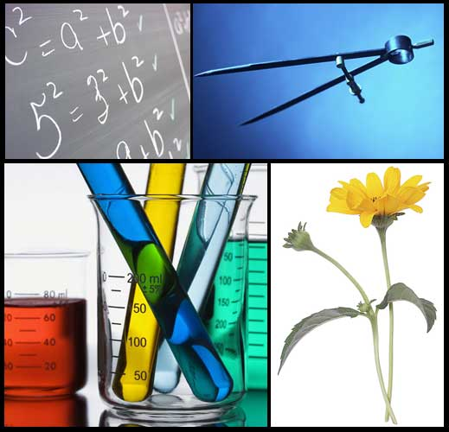
Effects of Scientific Revolution
1: New Knowledge of the natural world in physics, biology, chemistry, and medicine.

Slide 19
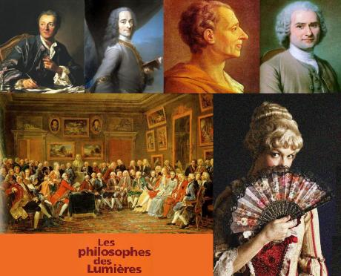
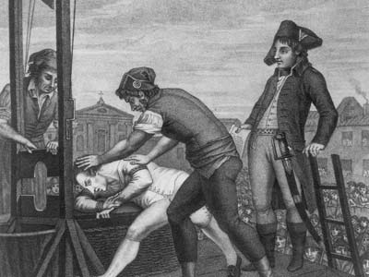
Effects of Scientific Revolution
2: Inspires the Enlightenment when people come up with new ideas for government.

Slide 20
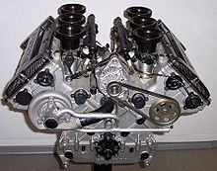
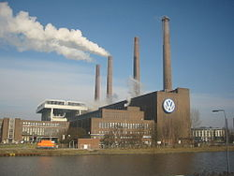
Effects of Scientific Revolution
3: Long-term: New Technology changes the world (ex. factories, engines, computers, internet, etc……).

Slide 21
Right Side/Left Side
LS Activity 1.2
Draw four boxes on the left side of your notes
Choose 4 of the following names and draw a picture which represents their achievements and contributions.
RS Notes 1.2
Power Point Presentation
Class Notes: The Scientific Revolution

Slide 22
