Slide 1
Role of a School Counselor
Not your average Guidance Counselor, We are School Counselors.
“Every Child Deserves A School Counselor”

Slide 2
History
The School Counseling framework has evolved overtime from simply guidance.
We are no longer Guidance Counselors, the preferred name and title based on ASCA is School Counselor.
The title School Counselor encompasses the diversity and broad scope of the duties.

Slide 3
American School Counselor Association:
What is a Certified School Counselor?
A Certified School Counselor is a professional that:
Possesses a Master’s Degree in Counseling with a concentration in School Counseling.
Has unique theoretical and developmental training.
Has a holistic viewpoint of children to address the forever growing and changing needs of the 21st century learner.
Works collaboratively with key stakeholders to meet the academic, social -emotional, and post secondary needs.

Slide 4
The role and responsibility of a School Counselor
As defined by ASCA and NYSCCA:
Direct services: responsive services, crisis response, group, individual, appraisal, assessment, advisement, developing post- HS plans, and encourage parental involvement.
Indirect services: collboaration, consultations, referral, leadership, advocacy and teaming.
Annual student progress review: review students goals, academic, behaviors and attendance progress with grades 6-12 yearly.
Core instruction and lesson plans: Provide students with classroom instruction coupled with lesson plans that are aligned with ASCA.
Data Driven practices: Use of data to inform decisions, pre and post test/surveys.
Has a caseload of no more than 1:250 students.
Notes:
Provide chart with high versus low performing school counselors

Slide 5
RCSD School Counseling Mission
To provide a comprehensive, developmentally age-appropriate and sequential school counseling program that is aligned with the New York State Learning Standards and national (ASCA) and state (NYSSCA) standards.
School Counselors address the academic, career and social-emotional development needs of students with a global perspective. School Counselors work collaboratively with families, staff, and community partners to prepare students to become effective 21st century learners, achieve success in school, and develop into contributing members of our society.

Slide 6
RCSD School Counselor Vision
Every student will acquire the academic and social-emotional skills, post- secondary preparation and career exploration to reach their fullest educational potential.

Slide 7
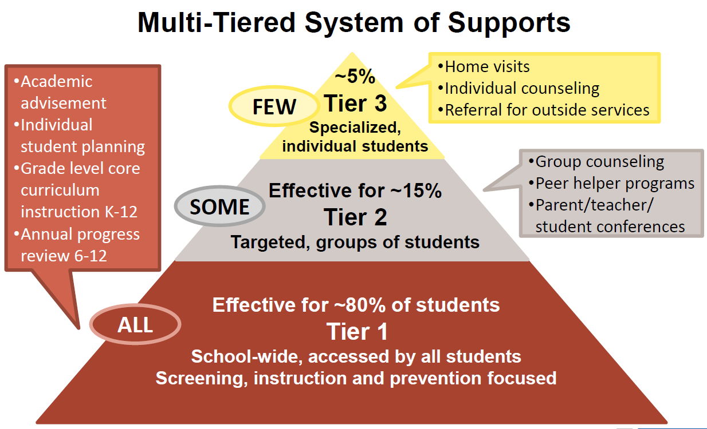
The role and responsibility of School Counselor
Notes:
To meet the vision and mission of our department, we must Focus on Tier I, 2 and 3 levels.This will help increase outcomes for students. Counselors should spend most time on on tier I activities where most students are impacted.

Slide 8
New School Counseling Regulations
The work of the school counselor is viewed as important role for students, families, and the community at large. Evidenced by the American School Counselor Association and New York state rules and regulations that govern school counseling.
Part 100.2(j)
Part 80
Part 52.21
Notes:
Part 100(j). There must be a comprehensive school counseling program for all students in grades K - 12.
Counselors must complete an annual individual progress review for students in grades 6 -12. The review can include but not limited to academics, attendance, behavior and goal setting.
Part 80 & Part 52.21 Requirements colleges and students must uphold when pursuing a degree in School Counseling

Slide 9
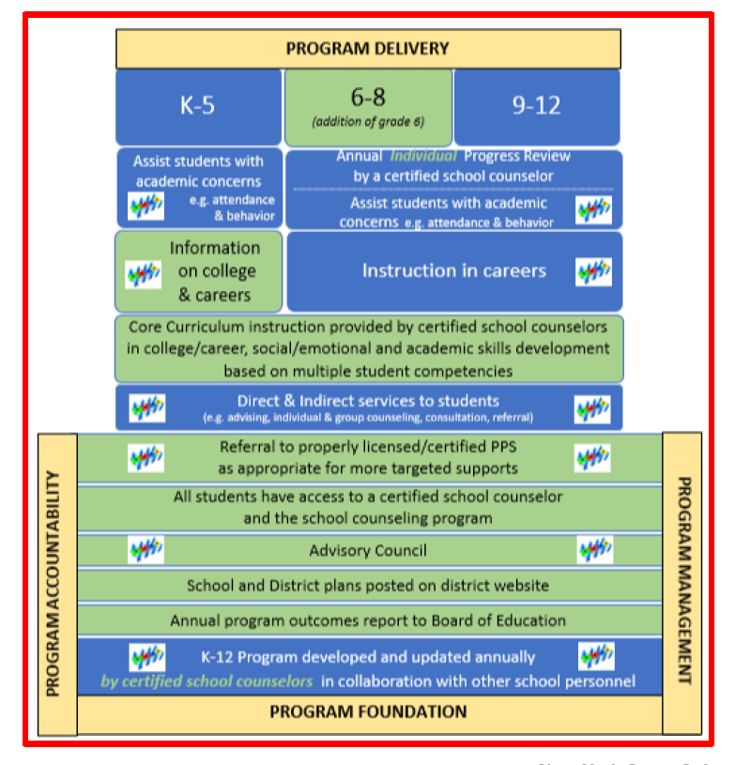
Part 100(j) - Requirements for School Counselors

Slide 10
Comprehensive School Counseling Plan
Per NYS Mandate:
Each school district must create a comprehensive school counseling plan aligned with ASCA and NYS standards. (policy adopted in July 2017).
Plans must be completed, presented to the Board and available on district website by September 2019.
Plans are utilized by all counselors to streamline duties and provide more consistency across the district.
Plan includes using the village approach to meet the needs of all students.
Notes:
Provide Executive Summary to colleagues

Slide 11
RCSD Comprehensive School Counseling Plan
The plan will include:
RCSD School Counseling Mission and Vision.
Role and Responsibility of a School Counselor.
A calendar of grade specific activities and duties aligned with ASCA.
*This is a living document and can be modified throughout the year to fit the needs of students.

Slide 12
Benefit of RCSD Comprehensive School Counselor Plan: Students
Assist in developing effective interpersonal relationship skills.
Broadens knowledge of our changing world.
Guarantees school counseling serves to every student.
Increases the opportunity for counselor-student interaction
Encourages facilitative, cooperative peer interaction.
Fosters resiliency factors for students.
Prepares students for the challenges of the 21st century by acquiring knowledge and skills in academic, career and personal/social development.
Connects the educational program to future success.
Facilitates career exploration and development.
Develops decision making and problem solving.
Assists in acquiring knowledge of self and others
Enhances personal-social development.

Slide 13
Benefits of RCSD Comprehensive School Counseling Plan: Parents
Prepares their children for the challenges of the 21st century through academic, career and personal/social development.
Provides support parents in advocating for their child’s academic, career, and personal/social development.
Develops a systematic approach for their child’s long-range planning and learning.
Increases opportunities for parent/school interaction.
Enables parents to access school and community resources.
Work as partners in their child’s education.

Slide 14
Benefits of RCSD Comprehensive School Counseling Plan: Teachers
Supports classroom Instruction.
Encourages positive, calendared activities and supportive working relationships.
Promotes a team effort to address developmental skills and core competencies.
Increases teacher associability to the classroom presenter and resource person.
Provides an interdisciplinary team effort to address student needs and educational goals.
Provides skill development for teachers in classroom management, teaching effectiveness, and effective education.
Provides consultant to assist teachers in their guidance and advisement role.
Positively impacts school climate and the learning community.

Slide 15
Benefits of RCSD Comprehensive School Counseling Plan: Administrators
Integrates school counseling with the academic mission of the school.
Provides a program structure with specific content.
Assists administration to use school counselors effectively to enhance learning and development for all students.
Provides a means of evaluating the effectiveness of the school counseling program.
Demonstrates school counseling accountability.
Enhances community image of the school counseling program.
Notes:
Admin and counselor relationship is crucial. Working and meeting regularly as a team improved outcomes for students.

Slide 16
Benefits of RCSD Comprehensive School Counseling Plan: Student Support Personnel
Provides School Psychologists, Social Workers and other professional student services personnel with a clearly defined role of the School Counselor.
Clarifies areas of overlapping responsibilities.
Fosters a team approach to enhance cooperation.

Slide 17
Benefits of RCSD Comprehensive School Counseling Plan: Community
Provides an increased opportunity for collaboration and participation of community members with the school program.
Creates community awareness and visibility of the school counseling program.
Connects the community to the needs of the school and the school to the needs of the community.
Enhances economic development through quality preparation of the students for the world of work.

Slide 18
Questions, Comments & Suggestions
Please visit our School Counseling webpage for more information and insight.
https://www.rcsdk12.org/Domain/74

