Slide 1
Power and Authority
What are they? How are they related?

Slide 2
DO NOW:
In your own words, define the following:
POWER
AUTHORITY
What is the difference between the two terms?
How are they related?

Slide 3
Power and Authority Reading Questions
What is power?
What does the author mean that power can be used subtly, not evident to the user?
How has government power changed since the 1950s?
What is authority?
Why do we accept authority more readily than naked power?
What is legitimacy? What is the ultimate source of legitimacy in the U.S. today?

Slide 4
Power
The ability of one person to get another person to act in accordance with the first person’s intentions
Threat of force, coercion, or fear is common in application of power

Slide 5
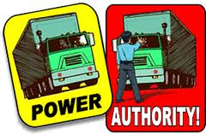
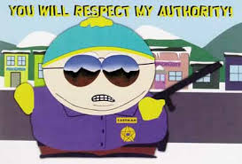
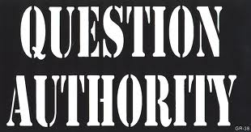
Authority
The RIGHT to use power.
Generally accepted use without threat, coercion or fear
Individuals follow those with authority because there is a general acknowledgement of power and agreement that it is for the mutual benefit of all. (Social Contract)

Slide 6
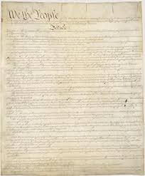
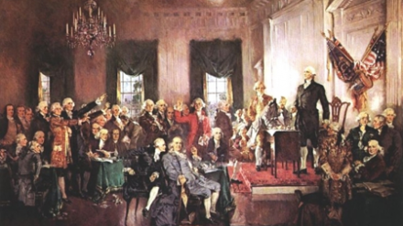
Legitimacy
Political authority conferred by a law or by a state or national constitution

Slide 7
Democracy
Rule of the many (literally power by the people)
Direct or Participatory Democracy
A government in which citizens participate directly (voting)
Representative Democracy (Republic)
A government in which leaders make decisions by winning competitive struggle for the popular vote.
Democracy is generally considered the most legitimate form of government.

Slide 8
The Enlightenment
A period of thinking in Europe during the 17th and 18th centuries which believed in applying scientific laws and ideals to social issues such as government
Two English thinkers began to write on the topic:
Thomas Hobbes in 1651
John Locke in 1690

Slide 9
Thomas Hobbes
Before government, life was “solitary, poor, nasty, brutish, and short” (Anarchy)
To improve lives, people joined together to form states (governments)
They made an agreement or contract with one superior person who ruled (Monarchy)
This idea of a Social Contract where people voluntarily gave up power for order and protection

Slide 10
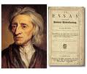
John Locke
Wrote that people are born with Natural Rights; Life, Liberty, and Property
People agree to obey a ruler and to pay taxes, in return, the ruler is obligated to protect the Natural Rights (Social Contract)
If the ruler did not protect these rights, the contract was broken, the people could then revolt and form a new government (lost their authority/legitimacy)

Slide 11
Other Enlightenment Thinkers
France made contributions as well:
Baron De Montesquieu: idea of separation of powers between branches of government
Jean-Jacques Rousseau: government gets power from the consent of the people
Voltaire: Freedom of religion and speech, quoted as saying “I hate what you say, but will defend to the death your right to say it”

Slide 12
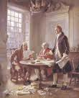
The American Revolution
The enlightenment writers of Europe had great ideas, but didn’t put them into practice. It was later in the American Colonies that these ideas would become actions. Thomas Jefferson stated them most eloquently in the Declaration of Independence.

Slide 13
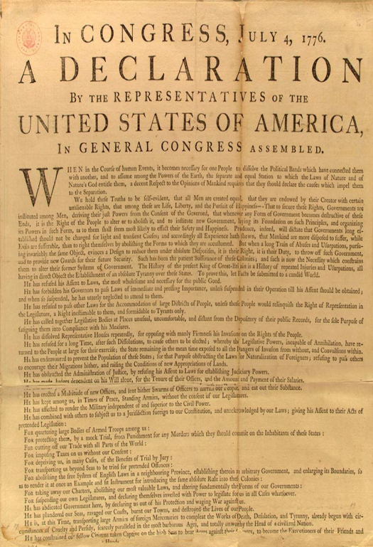
The Declaration of Independence
Purpose: To justify American independence
from England
Ideas: 1. All people have natural rights
2. Governments get power from
the consent of the governed
3. When government doesn’t do
its job, people have the right to
alter or abolish it!

Slide 14
Declaration of Independence.
Part 1: (in your notes)
Why do people, according to Jefferson, form governments?
What does Jefferson believe are the rights that belong to all men?
What “truths” does he believe are self evident?
What does he believe is the right of the people to do if the government does not protect these rights?

Slide 15
Declaration of Independence
Part 2: In your notes Create a chart with 2 columns
Column 1:
List 10 grievances (complaints) Jefferson states are the reason for separation from Great Britain
Column 2:
From your knowledge of U.S. government, how have these grievances been addressed. You may use examples from the Constitution, Bill of Rights, or other laws/traditions.

Slide 16
Declaration of Independence
Part 3: Conclusion (in your notes)
What conclusion does Jefferson come to at the end of the Declaration?
What powers does the U.S. now possess according to Jefferson?
YOUR OPINION (to turn in!):
Does our government adequately address the grievances Jefferson lists? Defend your answer!

